Slide 1
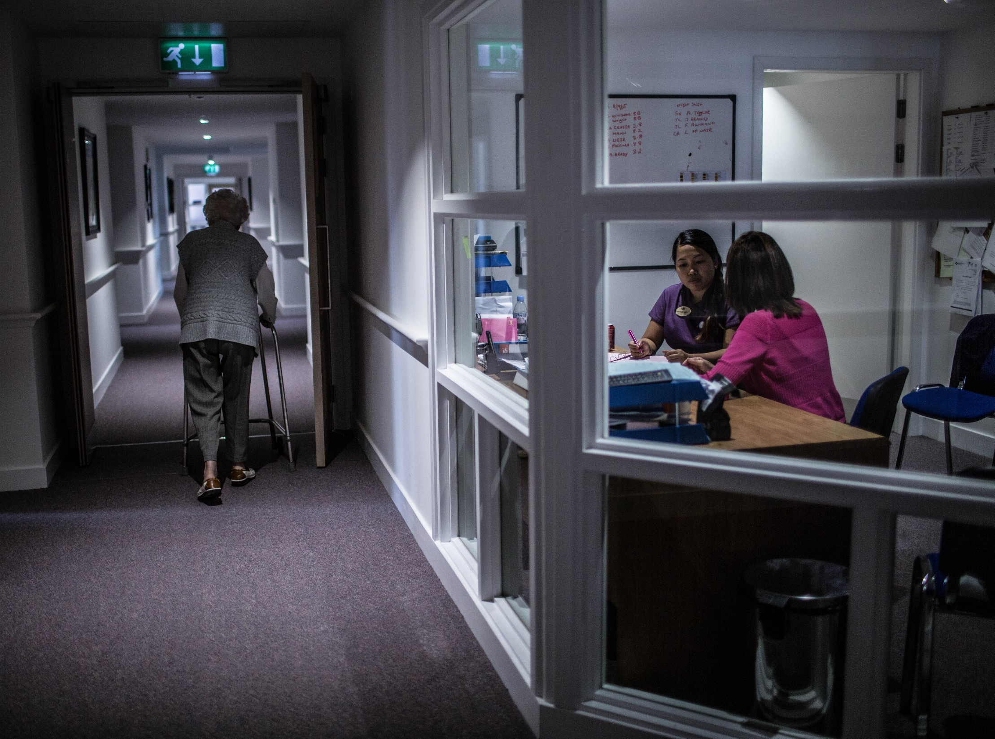

How do I make a difference to the service users I work with?
Photo: Greenlaw Grove Care Home

Slide 2
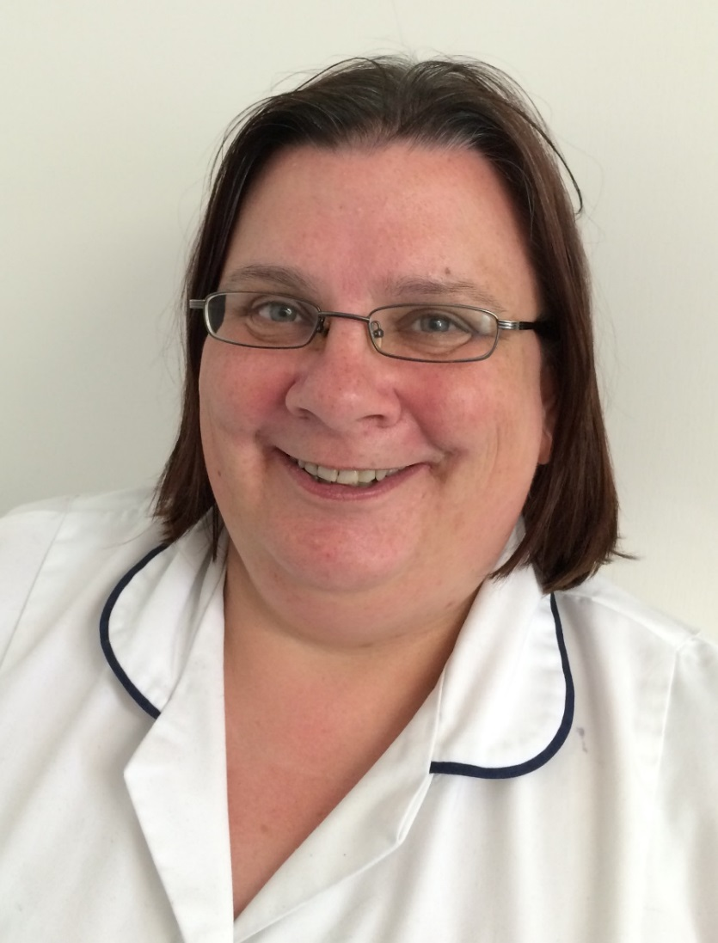
My residents are like my extended family, I work with them with professional friendliness to ensure that they are well cared for and feel at home within a nursing home environment.
Jakki Kyle
Staff Nurse, Windyhall Nursing Home, Ayr

Slide 3
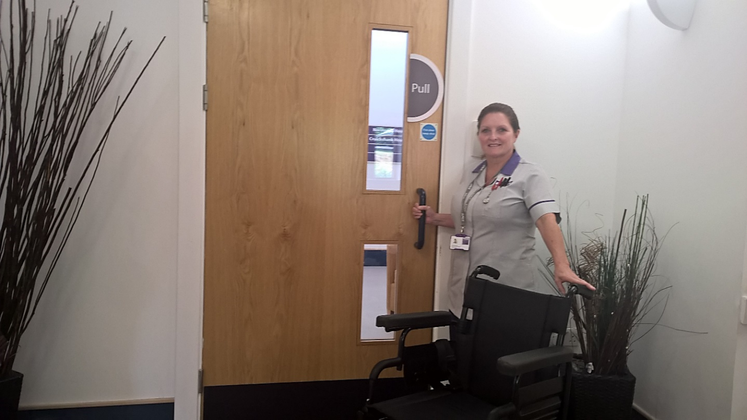

I feel proud and privileged to work with and enhance the quality of life of those who have worked tirelessly for our country.
Lorna Denham
Senior Care Assistant, Erskine
(Erskine provides care for veterans and their spouses)

Slide 4
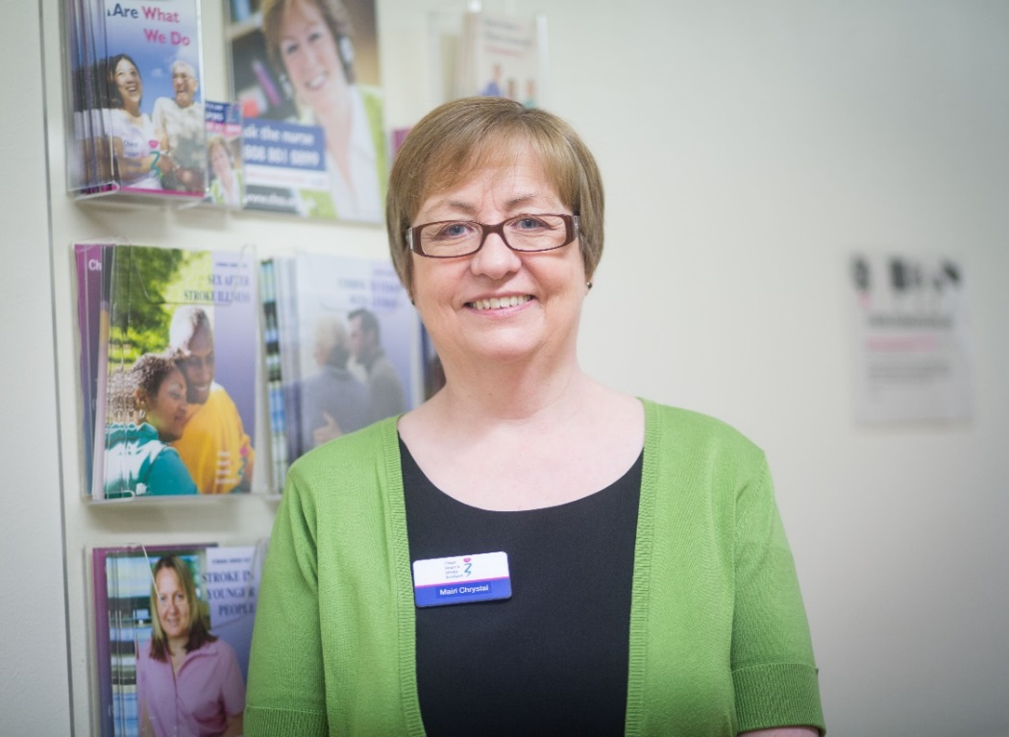
Service users are at the centre of everything I do in my work. I am an experienced nurse who has on-going training to maintain skills and expertise in my field, and that equips me to give my patients (and their carers and families): individualised information; confidence and support; and the tools to self-manage their condition and move life forward positively after stroke.
Mairi Chrystal
CHSS Head of Stroke Nurse Service
(based at the acute stroke unit,
Aberdeen Royal Infirmary)
Chest Heart and Stroke Scotland

Slide 5
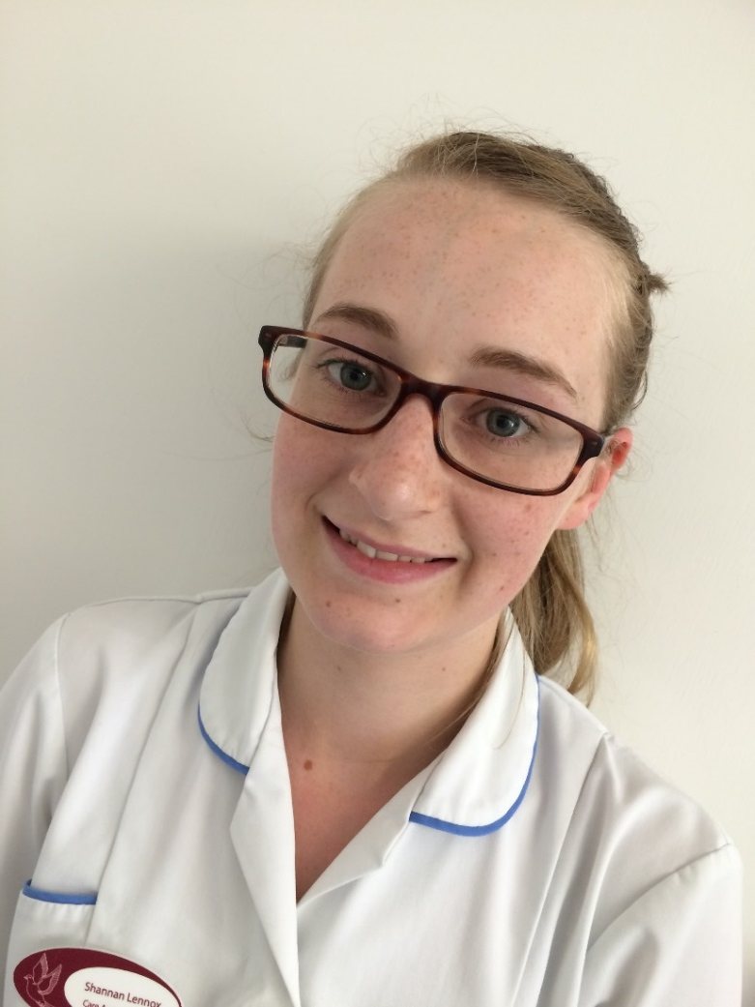
I make it easier when illness or
dementia make it harder.
Shanni Lennox
Care Assistant, Windyhall Nursing Home, Ayr

Slide 6
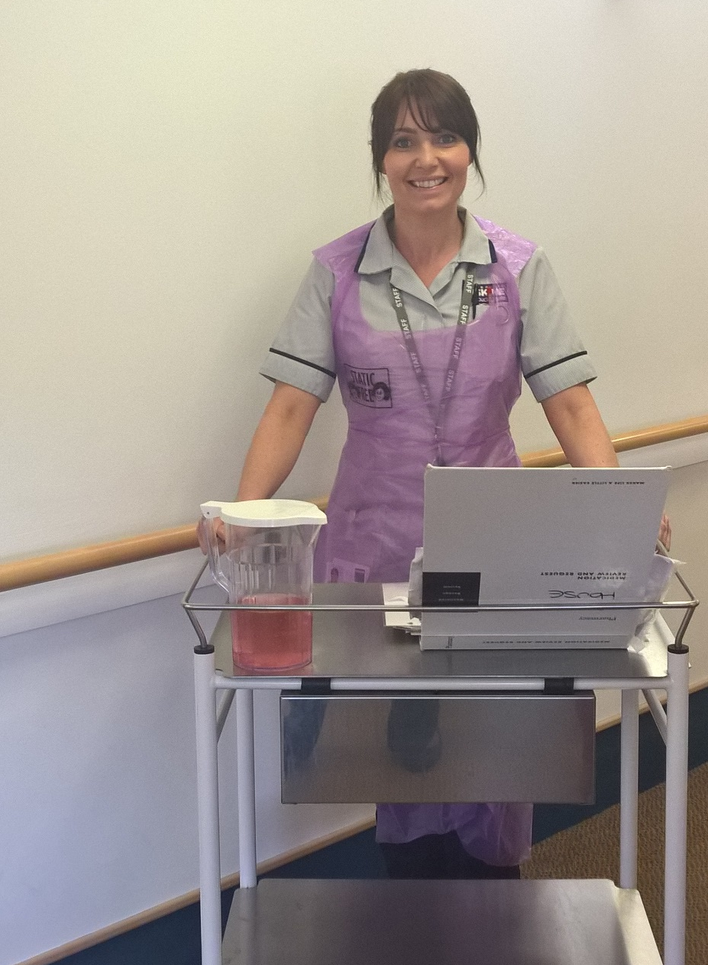
My day is not complete until I have seen a smile from the residents. It’s the little things I do that make a big difference to the resident’s life.
Pamela Nugent
Registered Nurse, Erskine

Slide 7
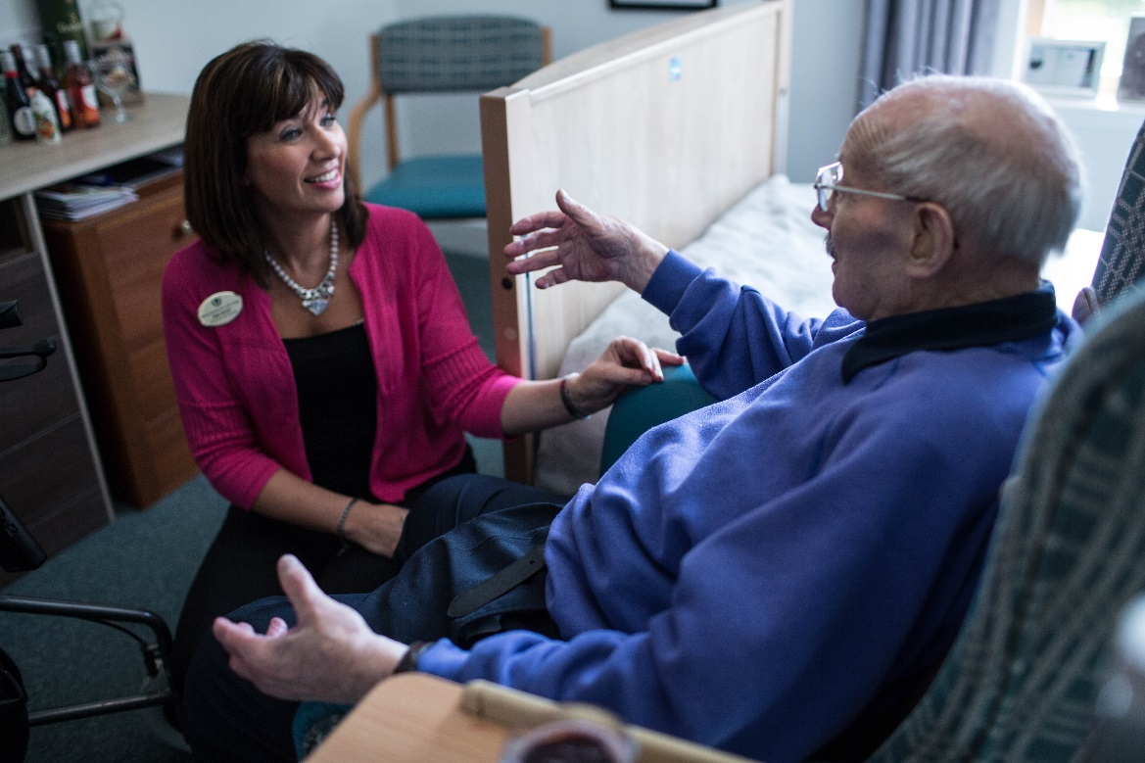
Iona Mackay
Home Manager
Greenlaw Grove Care Home
Greenlaw Grove is our residents’ home first and foremost: they don’t live in our workplace, we work in their home, so it is very important that they have their say in how things are run. It is also important that expert nursing and care support is available to them when they need it. We maintain social health and wellbeing by having a strong team of clinical staff to manage the times when a person isn't so well.

Slide 8
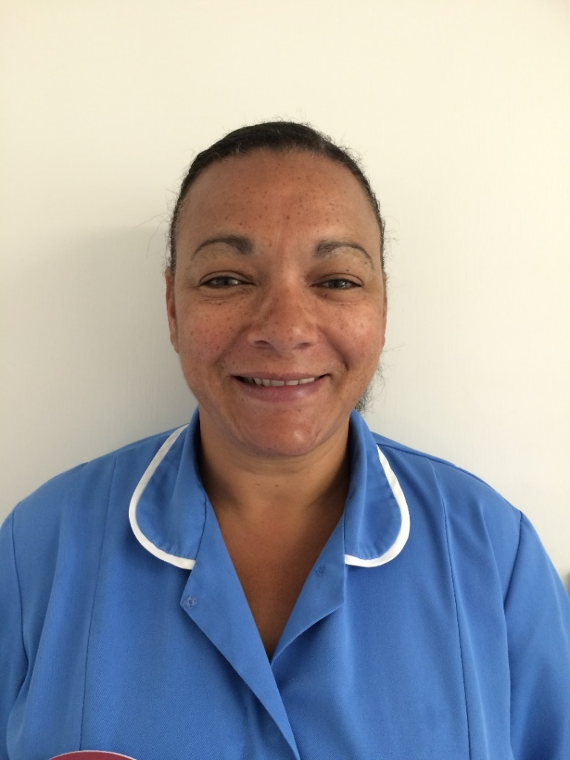
I make a difference to the service users because person centred care to the individual is very important, to meet the service users needs and own little habits.
Janet Kay
Keyworker, Windyhall Nursing Home, Ayr

Slide 9
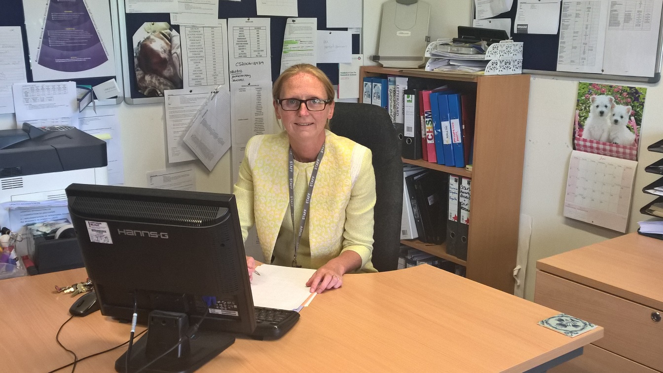
There is no greater reward than contributing to the development of a warm safe homely environment for our residents who have had to leave the home they spend a lifetime building, due to the ageing process.
Lesley-Ann Wylie
Care Home Manager, Erskine

Slide 10
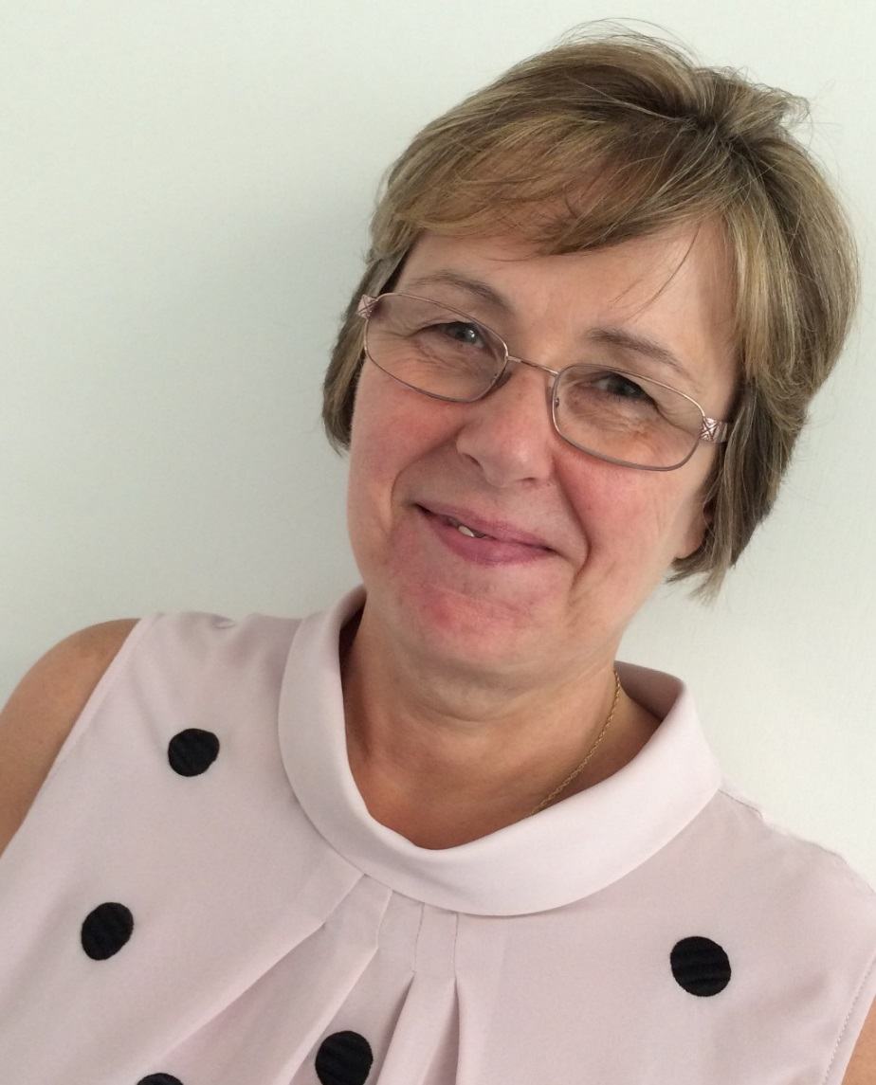
While taking care of my residents’ physical and mental health, I ensure that they are safe, happy and comfortable in their home.
I also make friends and family feel welcome and promote good communication with them.
Janet Kay
Deputy Manager,
Windyhall Nursing Home, Ayr

Slide 11
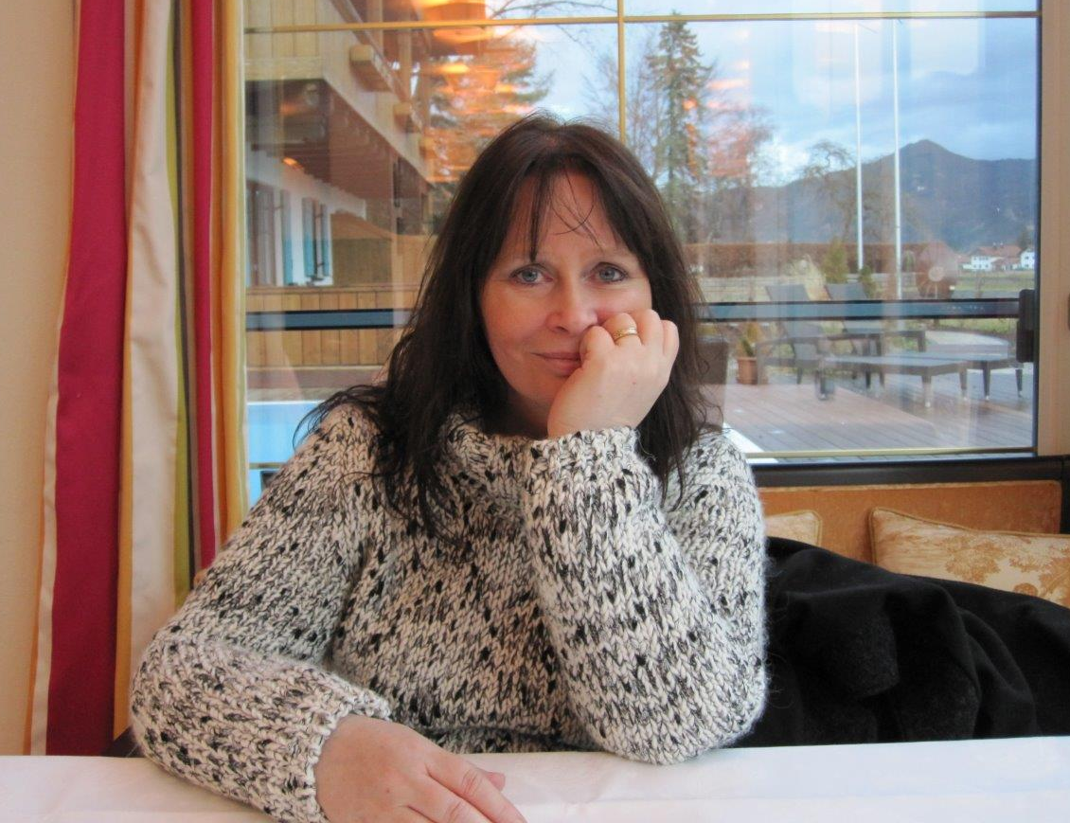
I became a psychiatric nurse, because I care and it mattered to me the interventions people in mental distress are offered are effective and enable them to move on with their lives. I wanted to find new ways of easing mental suffering and with others committed to shared decision making we started the charity COPE Scotland and from what people using our service say; I think we are on the right track.
“The support I have been given has allowed me to begin picking up the pieces of my life and the confidence to accept the good days AND the bad days” (Client of COPE)
Hilda Campbell
CEO, COPE Scotland

Slide 12
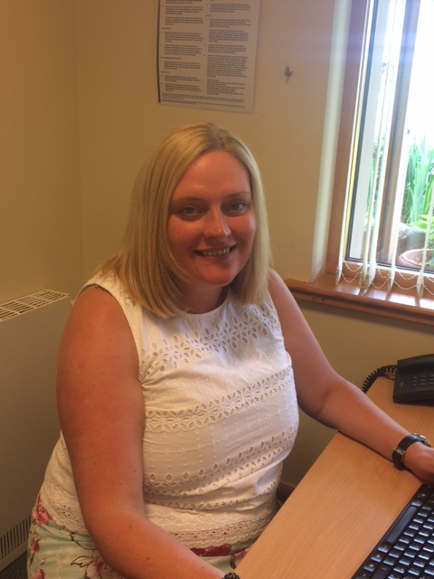
Safe practices, efficient processes and effective policies and procedures contribute to the high standards of care delivered to Erskine residents.
Pauline McIntyre
Clinical Governance/ Quality Improvement Manager, Erskine

Slide 13
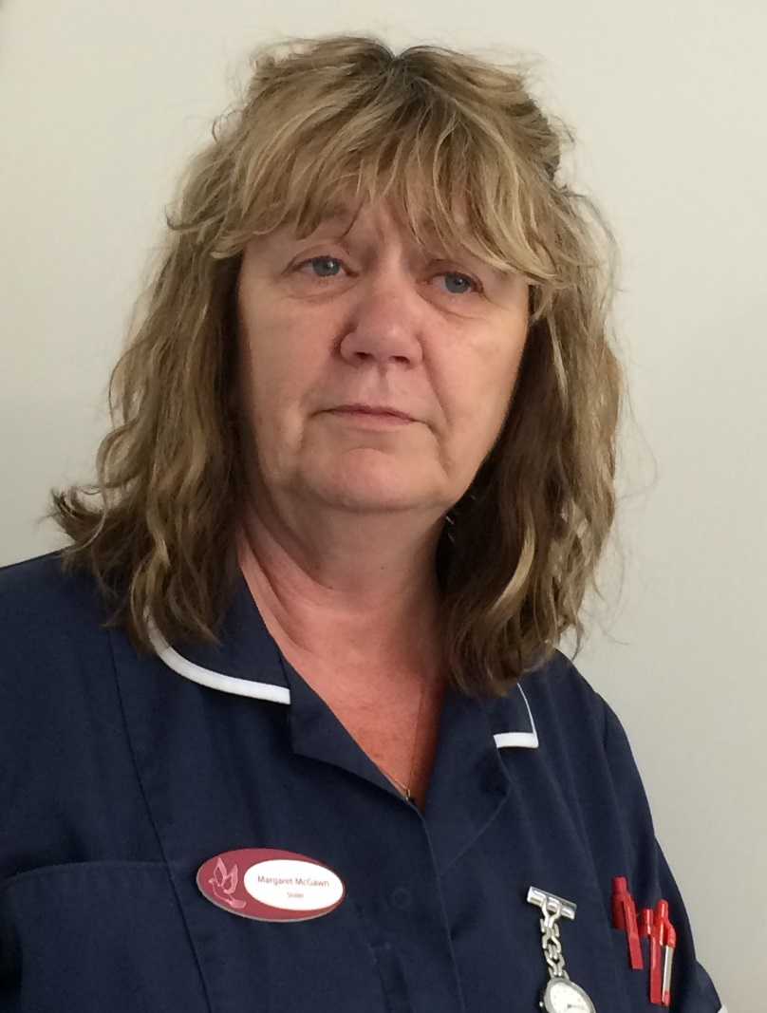
I make a difference to the residents I work with by giving my time and helping them feel safe and secure.
Margaret McGawn
Nursing Sister, Windyhall Nursing Home, Ayr

Slide 14
I worked in the NHS for 28 years and thought I knew everything! I came into the care home 3 years ago having retired from the NHS and then realising I wanted to still be involved in care. And I have discovered a whole new world - working in a care home is challenging but so rewarding.
It is an absolute privilege to be able to care for people in their twilight years when they are usually at their frailest and most vulnerable. They often come into the home from very stressful circumstances and families have done their utmost to look after their beloved parent but we are able to take that stress away and enable families to find comfort in the last few months/years of their parents’ lives without the stresses of caring.
Maxine Kinnoch
Care Home Manager
Rosepark Nursing Home

Slide 15
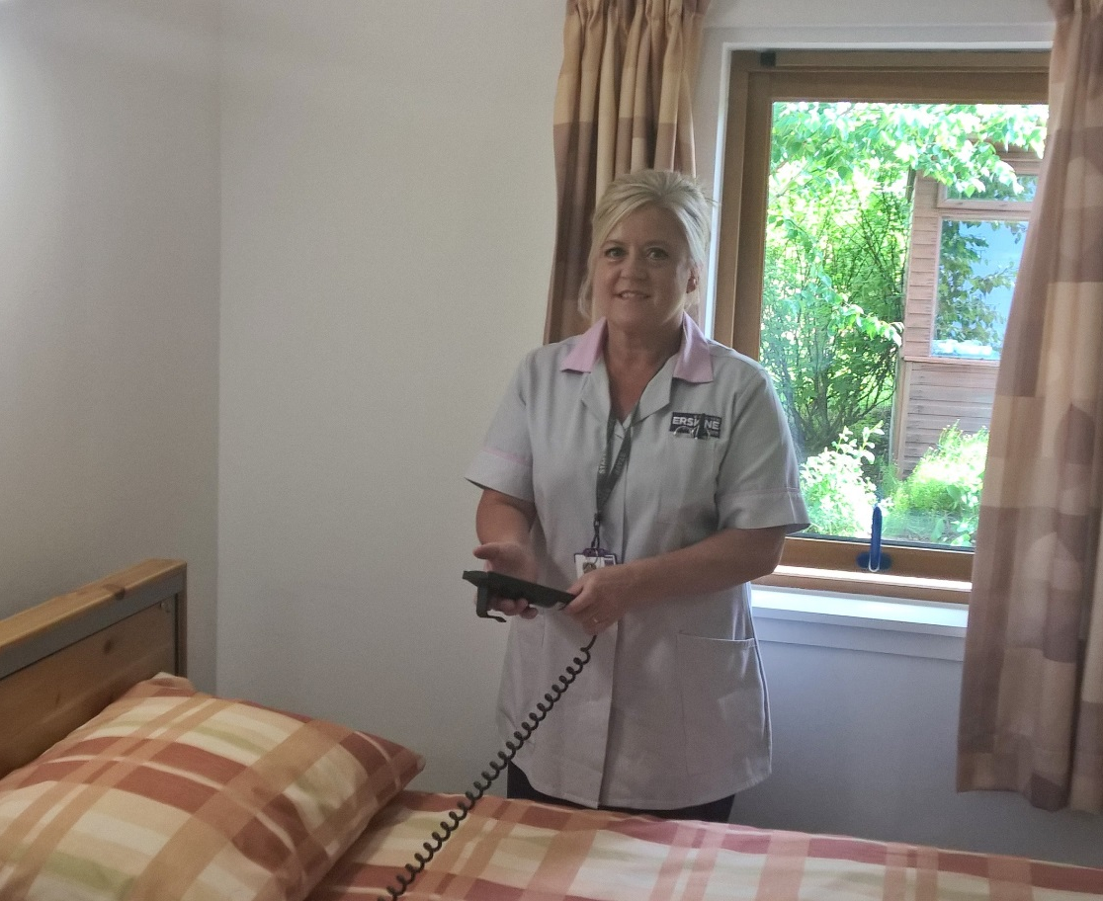
My job is an amazing opportunity to interact with and get to know people. It is important to see the person not the disease.
Linda Callaghan
Care Assistant – Erskine

Slide 16
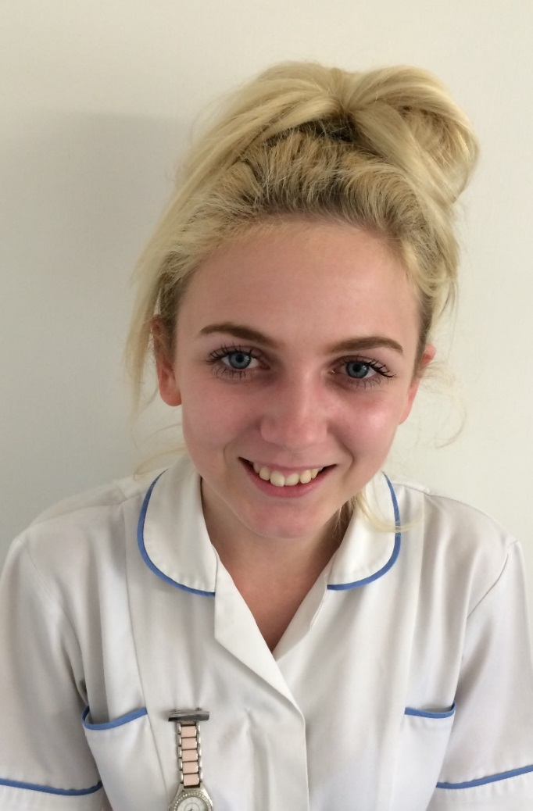
I make a difference to the residents I work with by dividing my time between my residents and ensuring that their needs and preferences are met.
Chloe Ferguson
Care Assistant, Windyhall Nursing Home, Ayr

