Slide 1
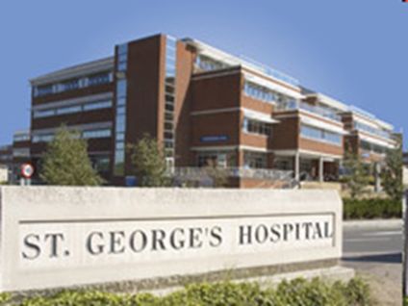
DEMENTIA and DELIRIUM
Moira Rowan
Nikki Zimmermann

Slide 2
What is Dementia?
A group of brain
diseases that
cause progressive
impairment of
decline and social
functioning
Definition of dementia:
Progressive, irreversible brain damage caused by a disease or disorder affecting the brain, leading to problems with memory, orientation, reasoning, thinking, perception, recognition, communication and the activities of daily living.

Slide 3
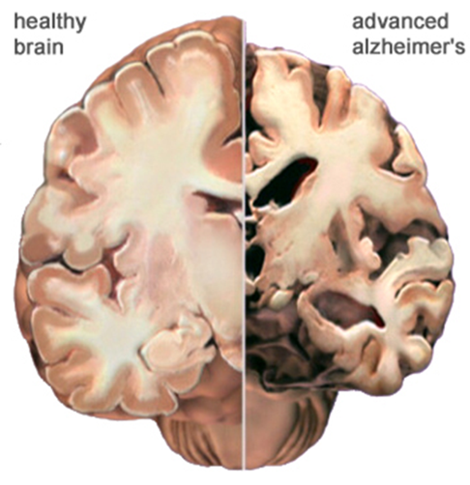
Layman’s description: ‘The brain is losing power and problems arise because it isn’t working properly’
‘Try to understand how hard it is for us…it’s just that you can’t see the missing bits that we are having to cope without’
(Christine Bryden, person with dementia)

Slide 4
850,000 people in the UK alone have dementia…… ….so who gets it?
Prevalence of dementia by age:
< 65 1 in 1000
65 – 70 1 in 50
70 – 80 1 in 20
80 + 1 in 5
Not everyone will develop dementia

Slide 5
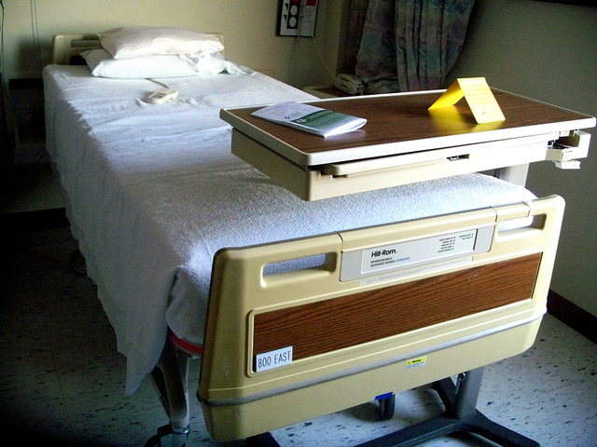
How many…….in St Georges
= 5,000 emergency admissions of patients with dementia every year
However, 43% enter hospital without a formal diagnosis
Rough estimate that 35 patients over 70 are admitted acutely to SGH every 24 hours

Slide 6
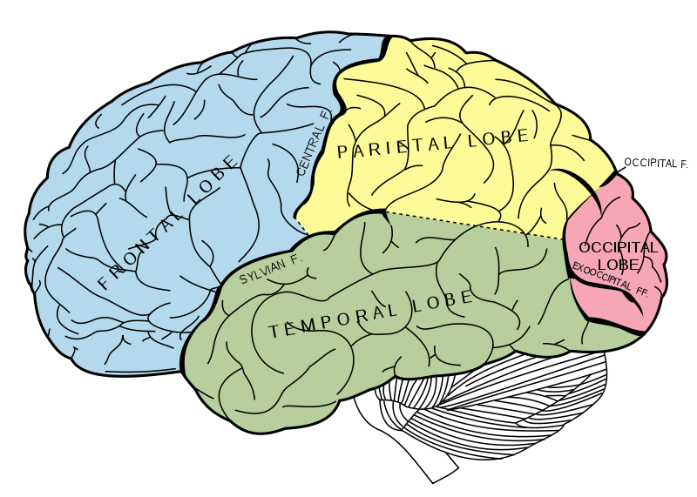
There are many different types of Dementia
It is vital to know the difference as they have different symptoms, behaviours and progressions

Slide 7
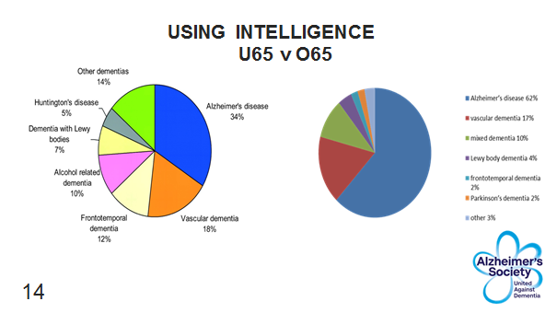

Slide 8
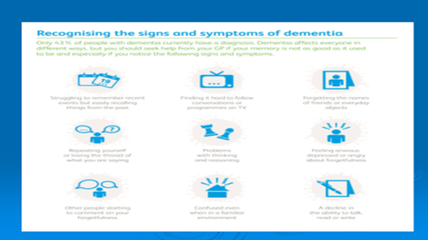

Slide 12
Alzheimer’s disease
The commonest cause of dementia after the age of 40
Characteristic presentation is with impaired episodic memory
Prominent visuospatial and language problems can also be seen

Slide 13
Vascular Dementia Usually related to standard vascular risk factors Cognitive slowing executive dysfunction Apathy gait apraxia

Slide 14
Fronto Temporal Dementia
Three main clinical syndromes
Behavioural variant
Progressive non-fluent aphasia
Semantic dementia

Slide 15
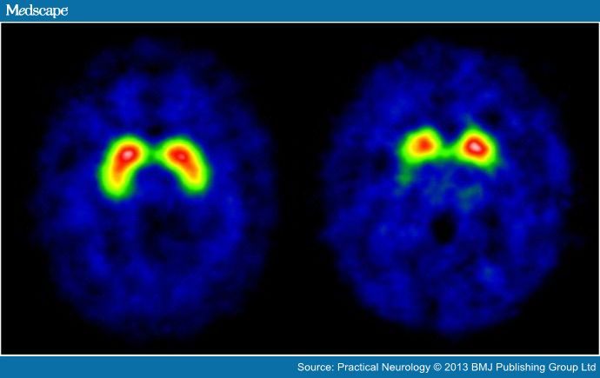
Dementia with Lewy Bodies
80% misdiagnosed
DAT scan
Dopamine is a transmitter the brain uses to stimulate movement and is diminished in individuals with Parkinson’s disease and LBD
Cognitive decline, particularly affecting executive function, attention & speed
Fluctuations in cognitive level
Visual hallucinations
Sleep behaviour disorder
Parkinsonism tremor
Pathologically and clinically related to Parkinson’s Disease

Slide 16
CSF - lumbar puncture
Research suggests
that Alzheimer's
disease in early
stages may cause
changes in levels
of tau and beta-
Amyloid.
In a symptomatic
person, a low Aß42
CSF level along with
high tau level reflects
an increased
likelihood of
Alzheimer’s disease.
Now being offered more widely especially for younger people

Slide 20
.

Slide 22
https://www.youtube.com/watch?v=U9W55UrzPb0
Video for I can prevent delirium Dr Sophie Bennett▶ 5:00

Slide 26
Team
Multi –disciplinary Team
Pathway
Process

Slide 27
ALZHEIMER’S SOCIETY
Working week
Pre screen
Prepare
Pre diagnostic Support
6 x Clinics -Peri Support
Post diagnostic support
Research Meetings
Hospital Meetings
Information Support Connect to local Communities
2 Services
at St George’s Hospital
Outpatients
Inpatients

Slide 31
DSW Working Day - St Georges Hospital
WARDS
St James Wing, Atkinson Morley Wing, Lane borough Wing, A & E and CDU
Referral Books
Richmond , Herbeden, Amyand
Dementia & Delirium Nurses (DAD)
Handover Boards & Nurse in Charge
Local Alzheimer’s Offices
Telephone Enquiries
Notes:
. Referrals – how I identify people in the hospital who need help
. DAD nurses – How I work with them, what they do
. How long it can take when I do talk to families, CRS etc.
. Being sensitive with information and approaching families sensitively

Slide 32
The Butterfly scheme
Enable Staff to respond appropriately and positively to people with dementia, those with memory impairment, or temporary confusion
Opt in -> discreet symbol placed above ward bed, on patient information and on their wristband
The butterfly symbol represents a request for a specific care response and everyone on the hospital team is involved in delivering that care response
Patient gently reminded of what’s going on
Prepared for what happens next, no surprises
Bed area on ward kept consistent
Focus on cleanliness and fluid intake
Medical history is checked via records or carers
Instructions and information (including the taking of medicines) is offered
- Carers sheet/ Reach out to me document
The scheme continues to promote partnership
working between hospital teams and family carers –
‘The Triangle of care’
http://butterflyscheme.org.uk/
Notes:
. Scheme devised by a carer for her mother who had dementia = consulted hundreds of people with dementia, their carers, and staff involved in their care
. Opt in – inform any staff member on the ward you would like to be a part of the scheme, free no charge. Likewise staff should inform families about the scheme for them to then decide if they would like it in place or not
. Enables support in other departments and areas in the hospital during the stay
. Explain DAD role in educating staff on wards in the hospital – education is key, insight creates empathy and where there is empathy compassion flows

Slide 33
What we do with our intelligence?
Neurology
Referring on for Community Support
CRS
Important information on specifics of dementia to ensure correct support is given
Dementias differ so do people
Person Centred Care
Hospital DSW
Feedback to appropriate people involved in the care: DAD nurses, ward staff, Social Services
Referring on for community support following the discharge
Provide appropriate information, advice, and support whilst in the hospital
Refer to appropriate services within the hospital during admission
CRS

Slide 34
Now it’s quiz Time!!!
Prizes to be won

Slide 35
Any Questions?
Moira Rowan
Nikki Zimmermann

