Slide 1
Addressing the barriers to BAME employee career progression to the top
Dr Jill Miller, Diversity and Inclusion Policy Adviser, CIPD

Slide 2
Aims of the work
Drive action on race equality at work through:
Bringing together what we know already
Add new insight about how we turn talk into action
Inspire action through case study practice examples
Articulate the central role that the HR profession has in making this change happen

Slide 3
Survey methodology
Survey of 1,290 UK employees, 700 from a BAME background and 590 white British (ONS ethnicity categories used)
Asked questions about different aspects of career progression:
Factors influencing career achievement to-date
Development opportunities
Ambition
Organisation culture
Organisation support to help people achieve their potential
Line manager support for career development
Compare results between and within groups

Slide 4
Findings

Slide 5
Factors influencing career achievement to-date
Significantly more BAME employees said career progression is an important part of their working life than those from a white British background.
However, BAME employees are more likely than white British employees to say their career progression to-date has failed to meet their expectations.

Slide 7
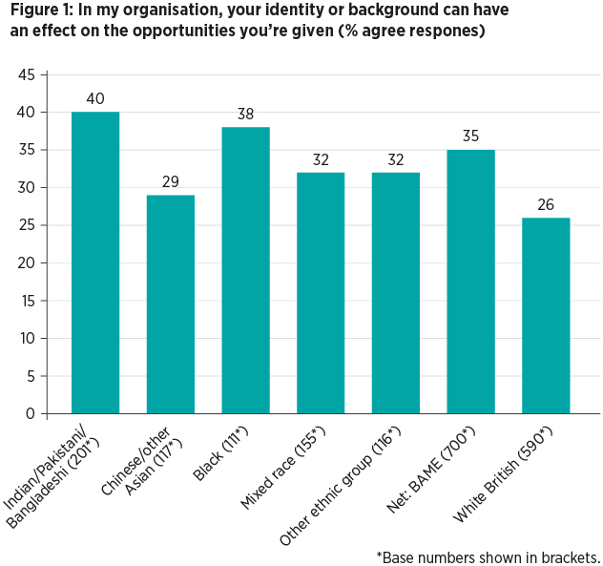

Slide 8
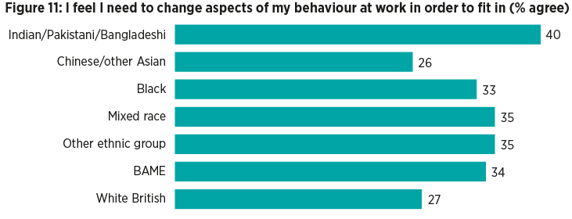
The impact of organisation culture
Just 3/5 of both BAME and white British employees feel their organisation has an inclusive culture.

Slide 9
Low level of line manager support for career development
Around 2/5 say their line manager discusses their training and development needs with them.
Only around half of employees across most ethnic groups feel able to talk to their manager about their career aspirations.
Around a third of both BAME and White British employees feel their manager makes assumptions about their career path and aspirations.

Slide 10
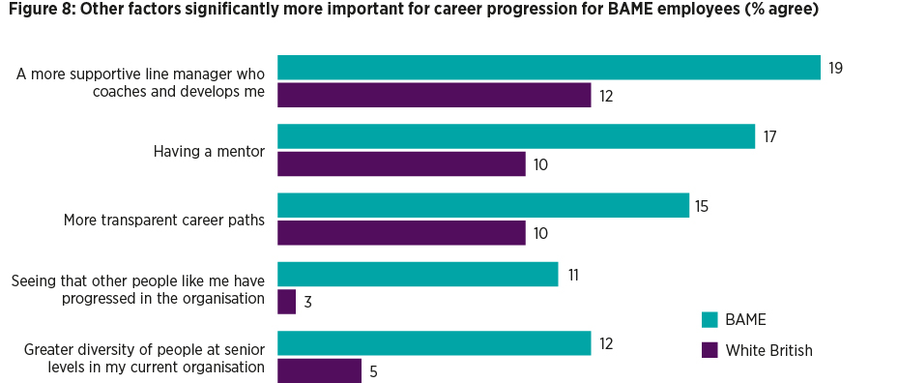
What would help kick-start your career?

Slide 11
Recommendations

Slide 12
Recommendations for employers
1. Understand what is happening in your organisation
2. Be aware of intersectionality and examine progression barriers through multiple lenses
3. Critically appraise your organisation culture
4. Actively encourage employee voice to inform change
5. Address unconscious bias

Slide 13
Recommendations for policy makers
1. Provide practical support for race pay gap reporting
We welcome Baroness McGregor-Smith’s recommendation for organisations to be publishing workforce data broken down by race and pay band.
The transparency achieved through data reporting will help focus attention and should drive action.
The complexity of tackling pay gaps across gender, race and disability as highlighted in research by the EHRC (2017).
Government has a key role in challenging any misconceptions that the pay gaps are entirely out of employers’ control.
We need lessons from gender pay gap reporting to inform the approach to both race and disability pay gap reporting.

Slide 14
2. Develop guidance for employer action
We’re reluctant to talk about race.
Employers may be uncertain of where to start.
fear of doing the wrong thing may be holding some employers back from doing anything.
3. Advocate and support better quality people management practice
Our research found that people management practice is poor across the board according to all ethnicities.
Government has a role to play in nudging and supporting employers to improve their people management capability at a local and a national level.

