Slide 1
Delivering disability equality in the workplace
Tracey Lazard: CEO Inclusion London

Slide 2
Who are we talking about ?
By using the term Disabled people I mean:
people with physical impairments
people with visual impairments
Deaf people
people with hearing impairments
people with learning difficulties
people with mental health issues
people with long term health conditions
people who are neuro diverse
people with hidden impairments

Slide 3
Historic and current exclusion and discrimination…
Treated as ‘other’, feared, pitied or viewed as of less value
Socially, culturally and economically excluded
Institutionalised
Little choice or control
Impact of austerity: rights going backwards, poverty, deprivation, poorer outcomes

Slide 4
Employment …..
30 % raising to 80% employment gap between Disabled and non-disabled people
Failure to retain staff that become disabled
Very significant non disclosure

Slide 5
How can we increase equality and inclusion in the workplace?
A real and genuine understanding of the value that diversity, access and inclusion brings

Slide 6
A real understanding of equalities issues and the barriers that exclude /marginalize people
For Disabled people that understanding starts with the challenging traditional views about disability

Slide 7
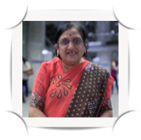
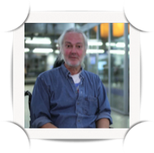
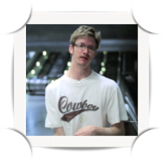
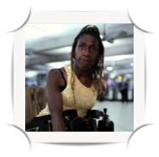
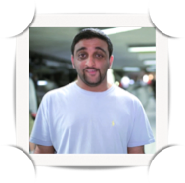
The Medical Model
Can’t talk
Wheelchair bound
Can’t hear
Special needs
Mentally ill
Can’t see
Less intelligent
Problem
Can’t walk

Slide 8
Disability – The Medical Model
Disability is about having something ‘wrong’ with you.
Disabled people have ‘special needs’ as a result e.g need day centers, ‘special schools’ and ‘special’ transport.
Disability is primarily a private issue for the individual.
Right response to disability is by trying to cure the individual or through pity, charity and sympathy.

Slide 9
Disability – The Medical Model
The lives Disabled people lead are inevitable consequences of having something ‘wrong’ with you..

Slide 10
The Social Model
Disabling World
Life Opportunities
Building Design
Segregation
Transport
Negative Media
Civil Rights
Prejudiced Attitudes
Education
Employment

Slide 11
The Social Model
Economic, social, physical, communication & attitudinal barriers prevent Disabled people from participating fully in society.
It is society that disables people with impairments. Disabled people have a problem because of discrimination and loss of human rights.
Disability is created by society.
Right response to disability is to change society: to end discrimination, remove barriers and create inclusion & equality

Slide 12
The Social Model
The Social Model is about change.
Discrimination is not inevitable.
Barriers can be removed: information, communication, access, the law, housing, employment, attitudes.
Disabled people must be leading the change.

Slide 13
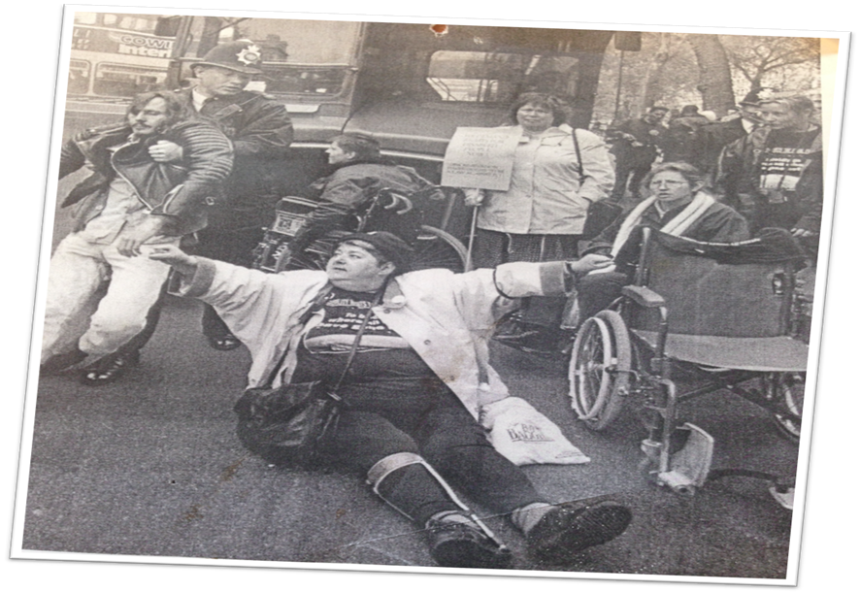
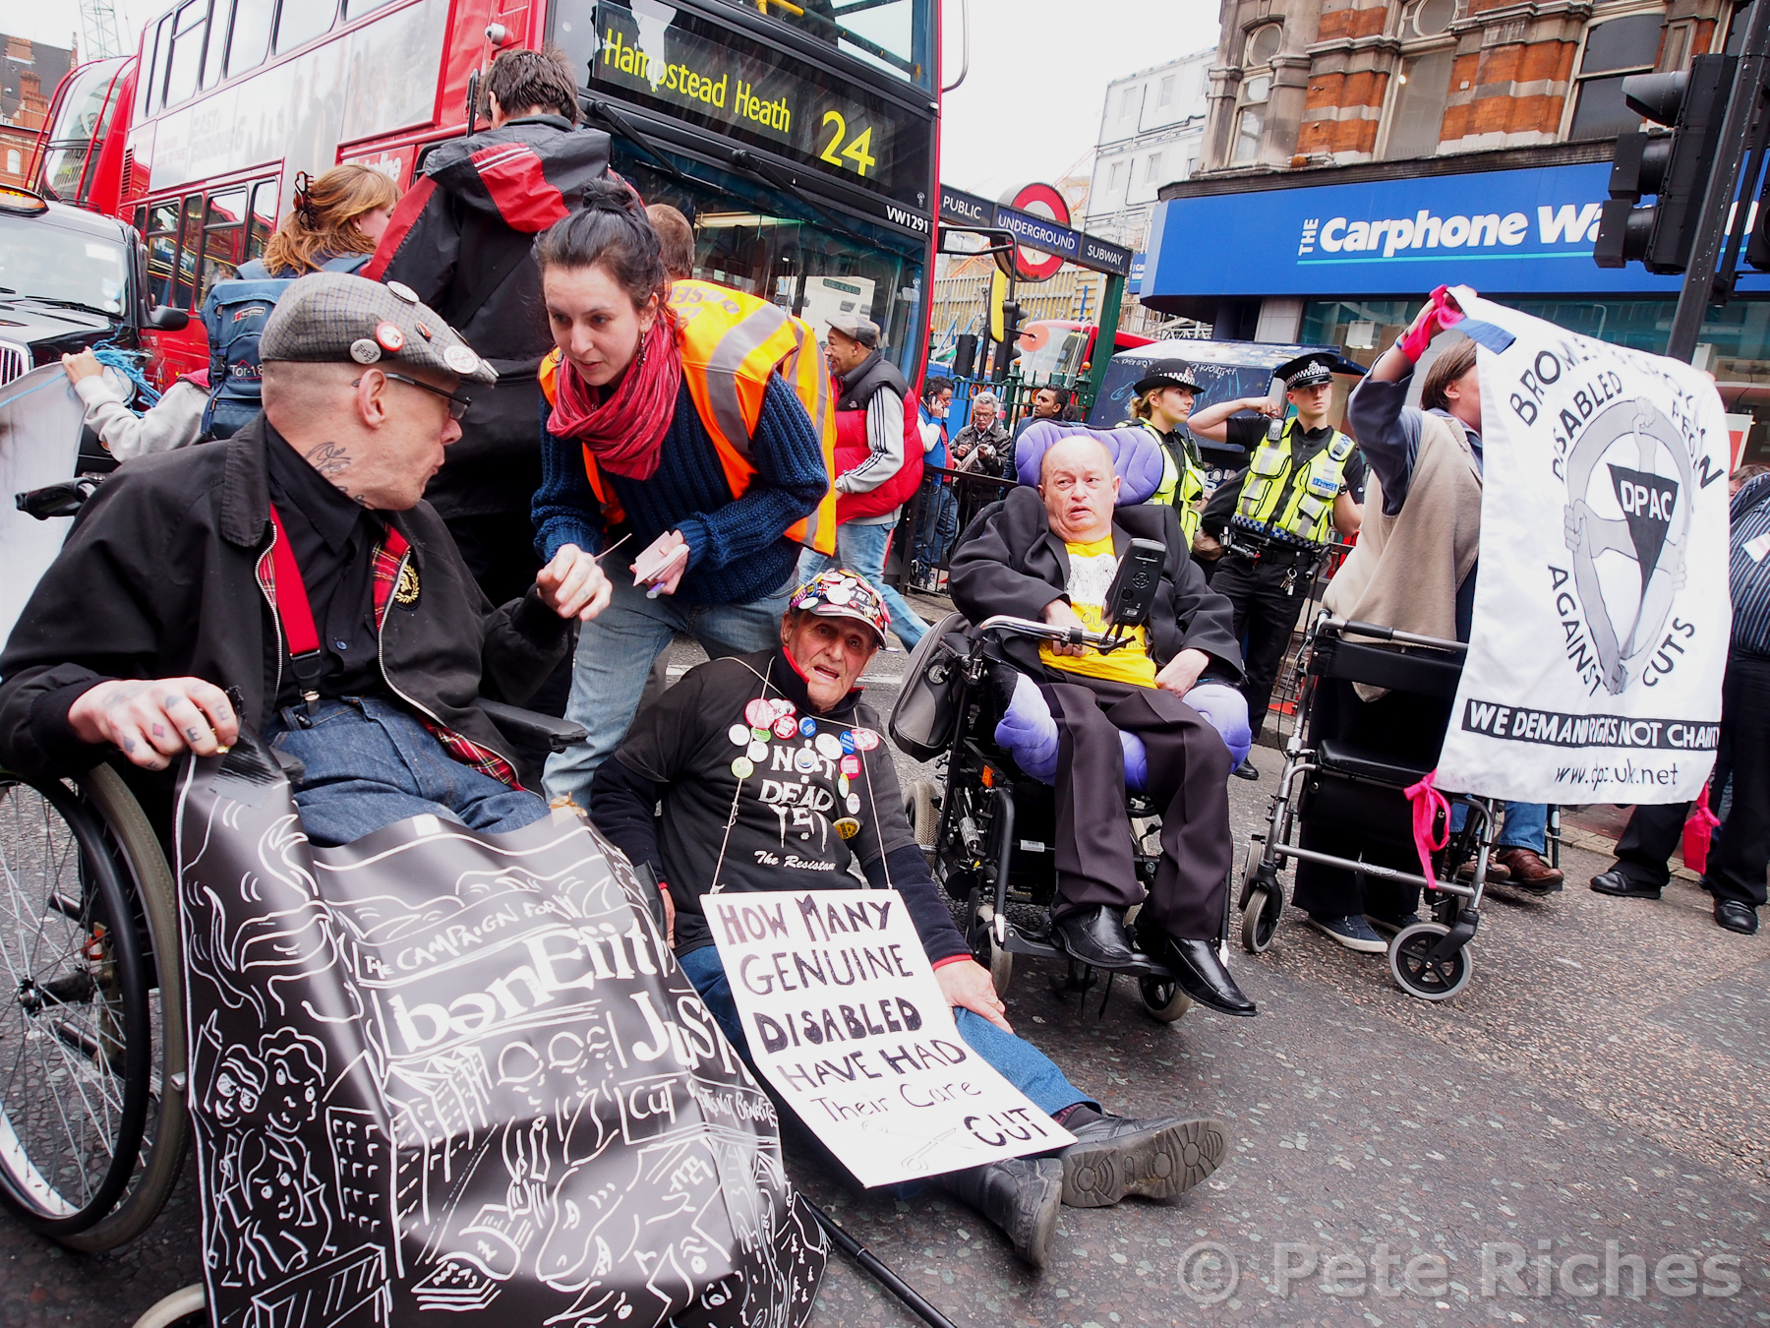
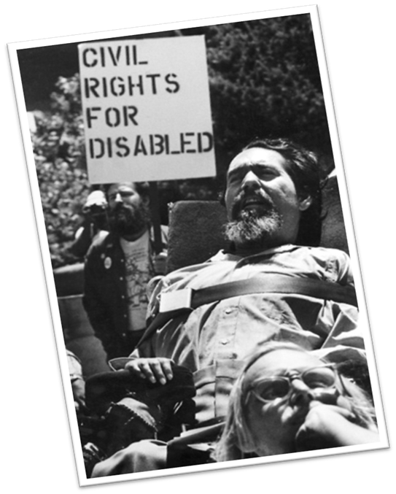
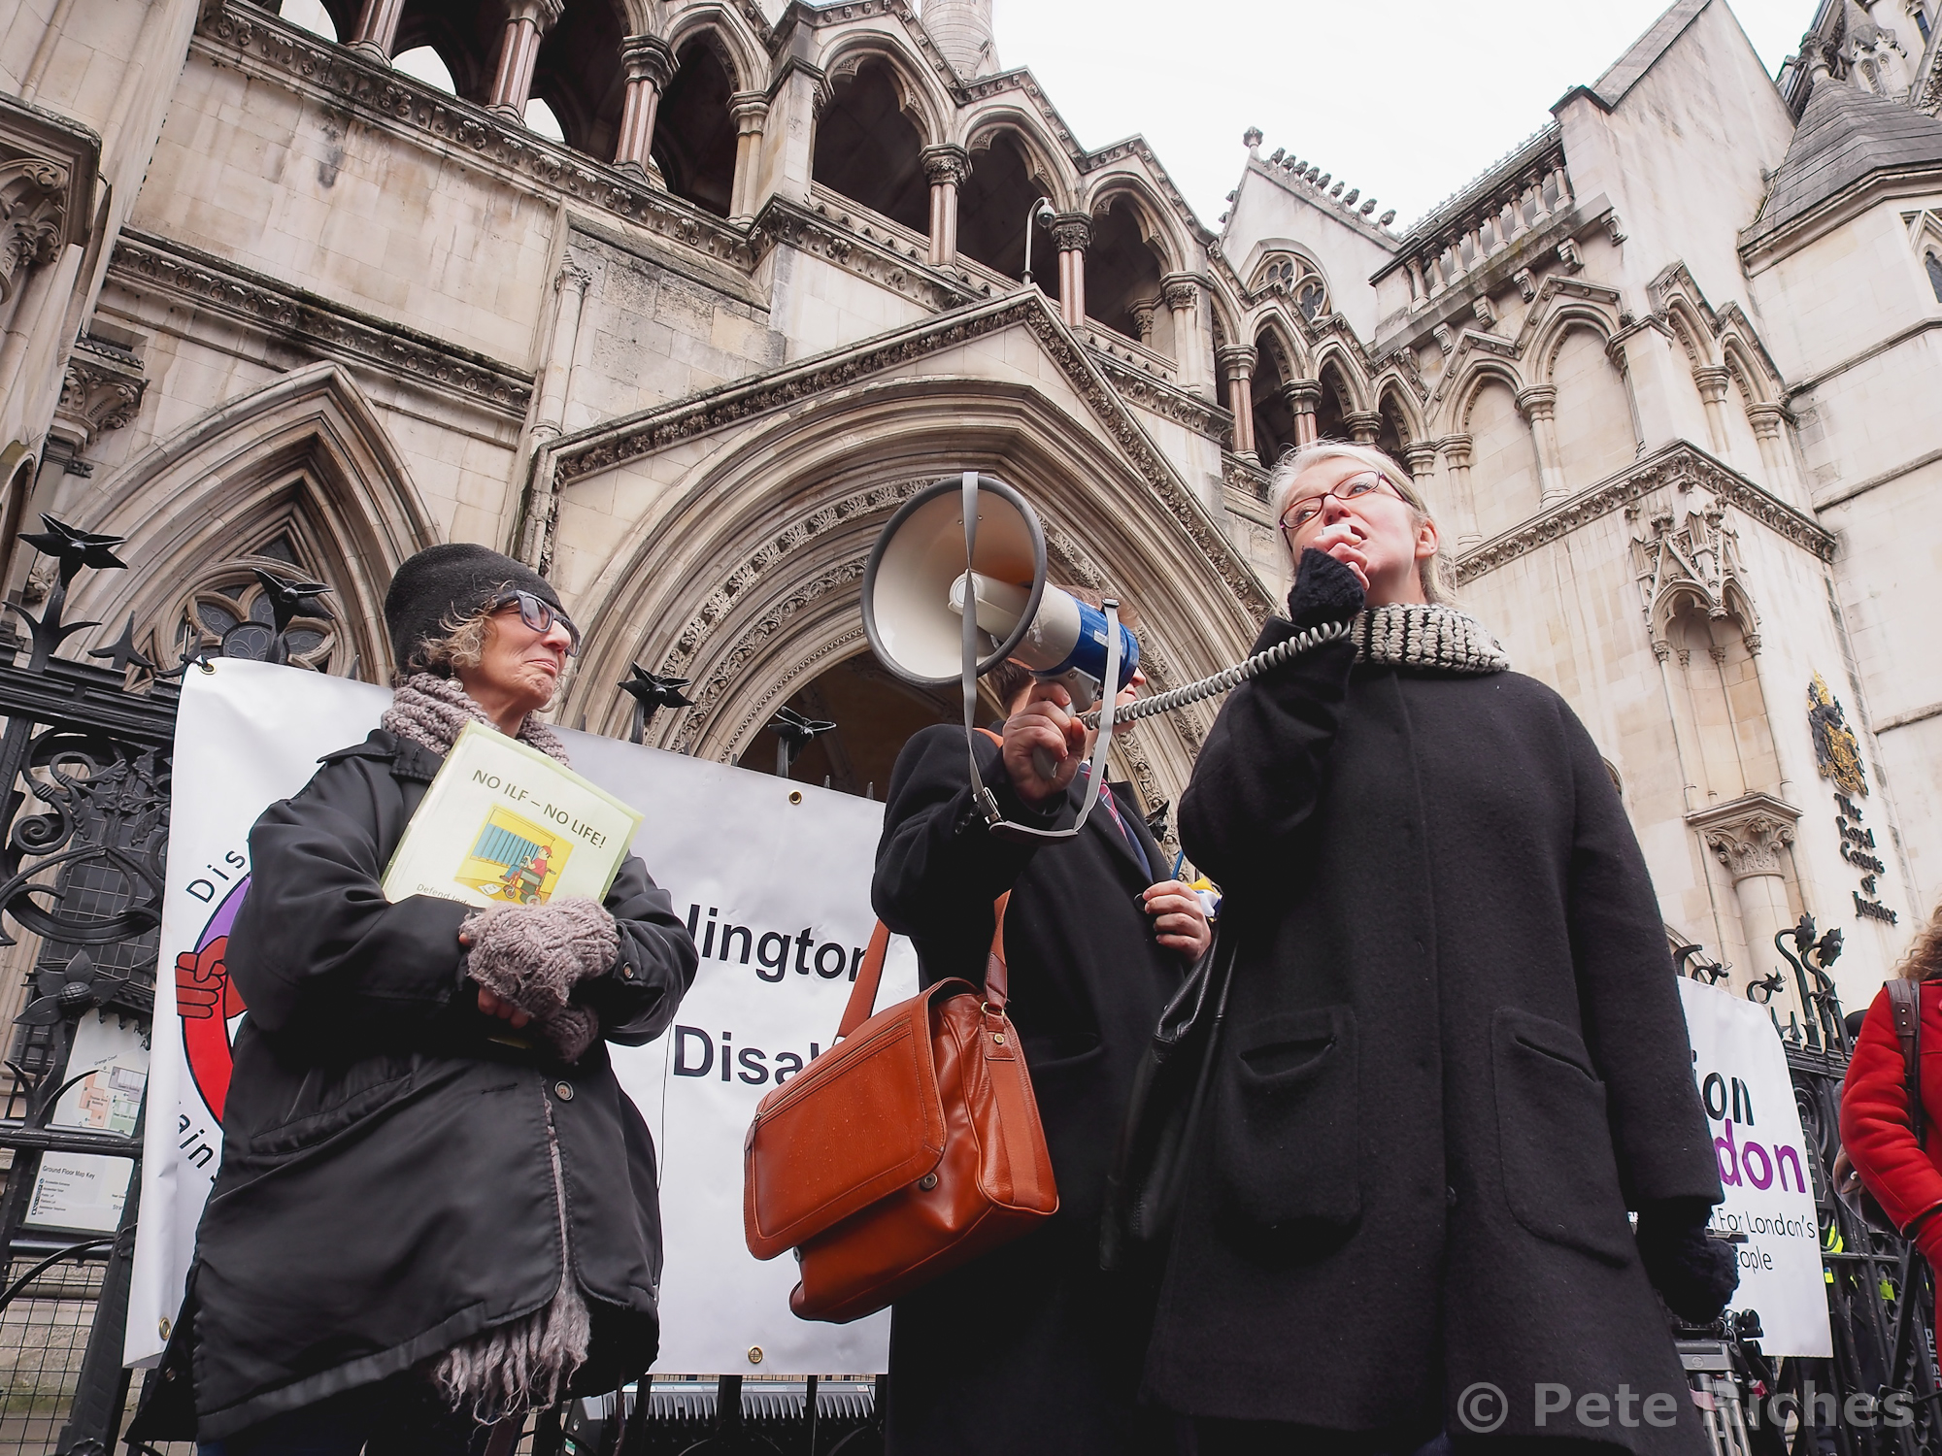
The history of the Disabled people’s rights movement
A journey from workhouse to workplace , from institution to independent living, from charity to human rights

Slide 14
What does an inclusive and accessible workplace look like?
Attitudinal and cultural
Organisational goals on diversity owned and performance assessed
Staff receive DET
Culture that openly talks about access and inclusion issues
Disabled staff networks encouraged and supported
Equality Act duties and rights understood

Slide 15
What does an inclusive and accessible workplace look like?
Right policies and practice:
Equality impact assessments are embedded in service reviews and development
Best practice is followed: Reasonable Adjustments Guide, Performance Management Policy and Procedure, Back to work Policy, Disability Leave Policy
Staff have skills, confidence and knowledge to raise and meet access needs

