Slide 1
Workplace Inclusion: What works well for sexual orientation and gender identity
Serena Sidaway Client Account Manager – Public Sector, Stonewall

Slide 2
Business case for an LGBT inclusive workplace
Greater employee productivity and performance – people perform better when they can be themselves
Attracting future talent; 49% of 18-24 year olds chose something other than 100% heterosexual when asked to plot themselves on a ‘sexuality scale’ in 2015. 23% of British people chose something other than 100% heterosexual
Increased awareness improves care for LGBT service users – LGBT people face specific health inequalities

Slide 3
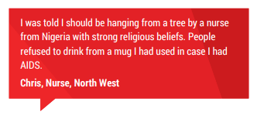
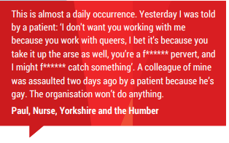
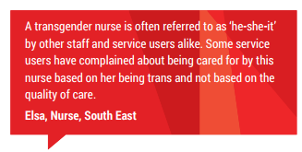
Staff experiences in Health &
Social Care

Slide 4
WEI 2018 – Health & Social Care
81% of LGB employees would feel comfortable reporting homophobic and biphobic bullying and harassment to their employer
37% of LGBT and 20% of non-LGBT employees have taken part in LGBT network group activity
58% of LGBT and 59% of non-LGBT employees agree that they can see visible role models who are gay men in their organisation. This drops to 15% of LGBT and 19% of non-LGBT employees who agree that there are visible role models in their organisation who are trans
22% of LGB employees have experienced negative comments or conduct from colleagues because of their sexual orientation at least once
Only 19% of trans employees would feel comfortable disclosing their trans identity to everyone at work

Slide 5
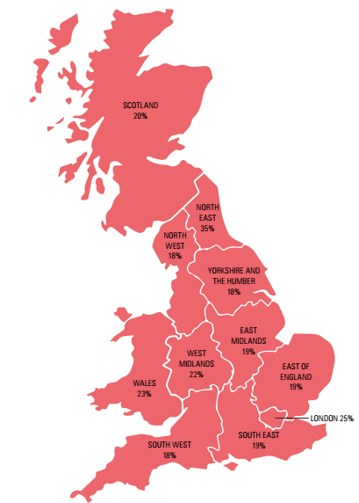
LGBT experiences in London
LGBT people who have experienced a hate crime or incident due to being LGBT in
the past 12 months – 25% in London

Slide 6
Stonewall Workplace Equality Index
Definitive benchmarking tool for employers to measure progress on lesbian, gay, bi and trans inclusion in the workplace.
10 areas of employment policy and practice
Staff complete an anonymous survey about their experiences of diversity and inclusion at work
434 organisations took part in the 2018 Workplace Equality Index

Slide 7
Stonewall Workplace Equality Index
Policies and Benefits
The Employee Lifecycle
LGBT Employee Network Group
Allies and Role Models
Senior Leadership
Monitoring
Procurement
Community Engagement
Clients, Customers and Service Users
Additional Work

Slide 8
What next?
Stonewall is working with over 70 health and social care organisations through the Diversity Champions programme
Stonewall is lobbying to reform the Gender Recognition Act
Stonewall Workplace Conference London 2018

Slide 9
Serena.Sidaway@stonewall.org.uk
www.stonewall.org.uk
Notes:
Close the session

