Slide 1
Portsmouth Branch
AGM – September 20th 2019

Slide 2
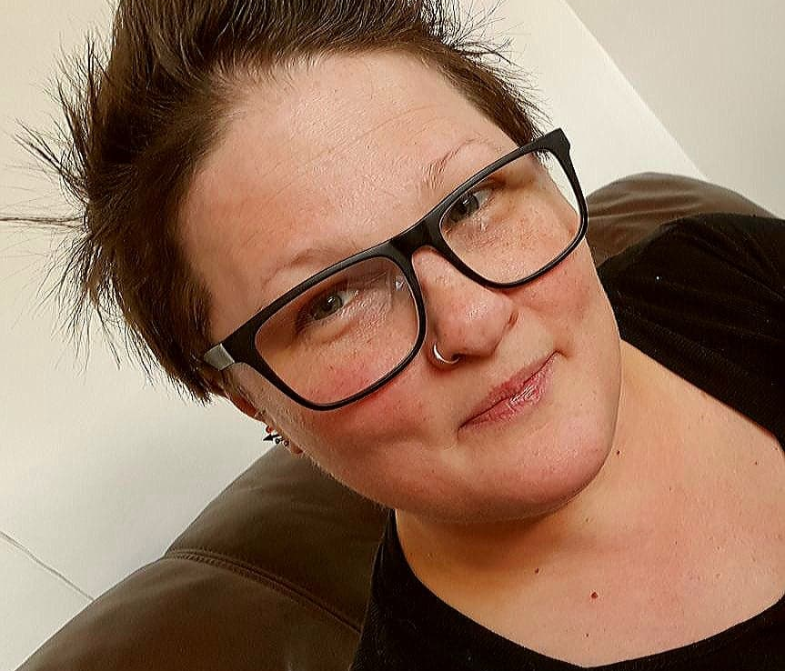
Introductions: Liz Jeremiah
Branch Chair
Workplace Steward (Rep)
RCN South East Representative on RCN Trade Union Committee
Ex Officio South East Regional Board member
Band 6 Sister – Critical Care QAH
Passionate about Safe Staffing, Staff Wellbeing, Healthy Workplaces, Staff Support, Pay, Speaking Out
Cat owner, generally a little unhinged and slightly bonkers
“Says what she thinks. EXACTLY what she thinks” (most of her colleagues and friends)

Slide 3
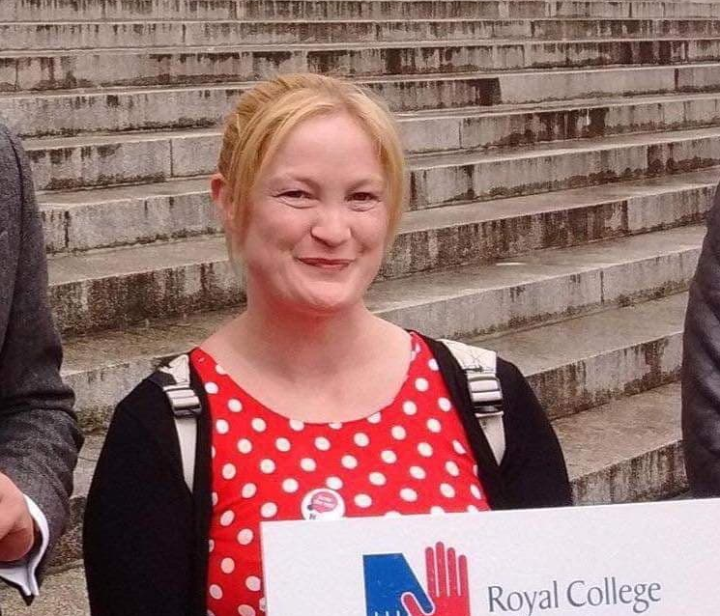
Introductions: Shelley Pearce
Branch Secretary
Workplace Safety Representative
Band 5 Registered Nurse – MOPRS (E4) QAH
Qualified teacher and committed to work place training and education
Committed to ensuring all in the nursing family have a voice and feel supported to perform and develop in their role
Outspoken speaker at Congress and to Press, MP’s and Parliament
Dog owner and mother
Strangely (and slightly unsettling) bendy elbows and possesion of infectious giggle

Slide 4
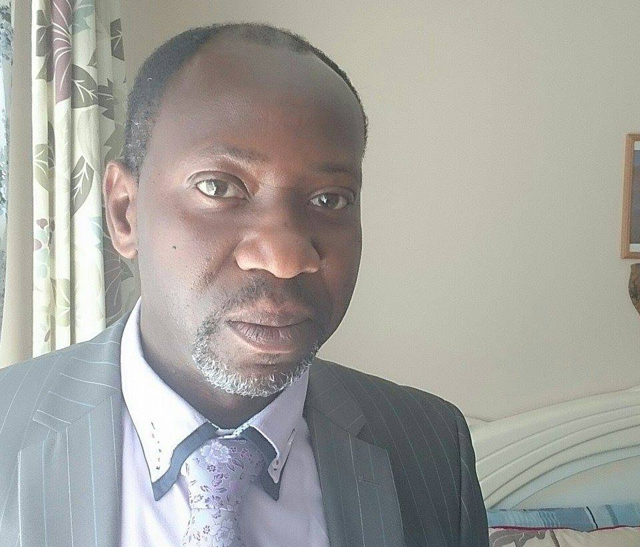
Introductions: Nwagwu Green Auiyigi
Branch Treasurer
Committed to CPD
Broad experience in many fields of nursing in both Italy and the UK
Particular passion in front line Emergency Medicine
Passionate about delivering care with a smile even in the most difficult of circumstances
Committed husband and father
Always dapper and mostly seen in suit

Slide 5
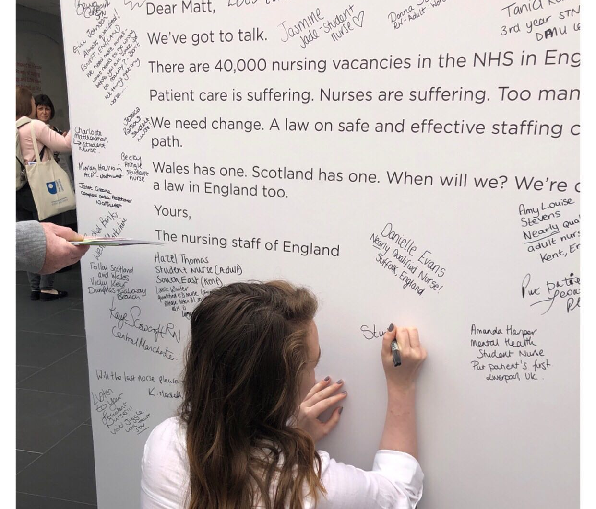
Introductions: Dana Brown
Student Information Officer (SIO)
3rd year (and about to qualify!) student nurse (adult) at Portsmouth University
Passionate about student nurse training and reinstating the bursary and funding for nurses CPD
Attended Congress 2019 – First time we have sponsored a St/N to attend the whole event as a voting member (yes – she behaved)
Type 1 Diabetic – deals with everything with tenacity
“Sometimes needs a push – but will knock down walls to achieve what she wants”
“Driven to look after people” (Alex – Dana’s partner)
“Obsessed with ‘bowel banter’ particularly in a group of nurses – but makes non-nurses shudder” (again – Alex)

Slide 6
Branch Financial Report – Nwagwu Green
Study Day – March 14th 2019
Budget £300 Actual Spend £249.61 (Catering, venue hire, speakers, travel)
Study Day – June 7th 2019
Budget £590 Actual Spend £252.07 (Catering, venue – speakers volunteered)
AGM – September 20th 2019
Budget £500 Actual Spend £195.84 (Catering – venue free, speakers volunteered)
Misc:
Printing of materials, committee meetings (refreshments), other branch costs for events/campaigning/”freebies”, administration etc
Budget £450 + £80 Actual Spend – ZERO!!!

Slide 7
Annual Report of Branch Activity 2019
Branch Learning Events:
March 14th – “What does the RCN do for me?”
June 7th – “Death and Dying – A Collaborative Approach”
September 20th – “AGM and Study Day”
Congress:
May 19th – 23rd
  We supported three fully funded members to attend Congress in Liverpool (Shelley, Dana and Edina)
  Accommodation and Travel was covered
  Congress was held in Liverpool at the ACC Arena – our members stayed in the Ibis Hotel (booked by the Regional Office)

Slide 8
Review of the Year – Branch Activities 2019
Learning Events:
March 14th – “What does the RCN do for me?”
June 7th – “Death and Dying – A Collaborative Approach”
September 20th – “AGM and Study Day – Safeguarding”
Branch Meetings/Committee Meetings:
February 21st
April 24th
July 18th

Slide 9
March 14th – What does the RCN do for me?”
Approximately 45 delegates attended
Speakers from:
  Library Services
  Regional Director Lindsey Meeks – Safe and Effective Staffing Campaign
  Legal Services
  Statements and Statement Writing – The importance of Reflection
  RCN Direct
  Member Support Services
  Getting Involved – Campaigning and “The Value of Reps”
The day was a great success – feedback was positive and members left with a greater understanding of what their membership included
Many members did not realise what they were entitled to and could access
The day provided 7 hours of CPD towards revalidation for Registered Nurses
Approximately 9 non attendees who had booked but did not attend – Estimated financial waste £45

Slide 10
June 7th – Death and Dying: A Collaborative Approach
Approximately 48 delegates
Agenda:
  Sudden Death in the Emergency Department – The Process and the Law
  Sudden Paediatric Death – The Process and the Law
  A Case Study – Mutiny Festival 2018 “Georgia Jones”
    ED team and special guest speaker Janine – Georgia’s mother (who spoke about her personal experience of losing a young daughter in unforeseen circumstances – the feedback was phenomenal)
  Palliative Care
  End of Life Care – Hospice and Home
The feedback for this event was amongst the best we have had
We have gone on to support “Georgia Jones – Don’t Go With the Flo” in support of Janine
The day counted for 7 hours of CPD
14 members who signed up did not attend – estimated financial waste £80 (of note we had a waiting list of 13 who would have liked to come and could have if we had been notified)

Slide 11
Branch Meetings/Committee Meetings:
All of our Branch and Committee meeting minutes can be accessed here:
https://www.rcn.org.uk/southeast/get-involved/branches/portsmouth
We meet as a Committee before during and after our events to discuss planning for the next and review the success, or failures of the previous. We work on what we can do better and how we can better respond to the needs of our members.
We are a small branch with only 2,500 members (approximately) so we endeavour to put on events which you ask us to. We will be asking for your suggestions for our 2020 plan later on today.

Slide 12
Congress: Liverpool 19th – 23rd May 2019
As a Branch we can fully fund 3 members to attend Congress each year – in 2019 we funded Shelley Pearce, Dana Brown and Edina Finn.
Dana was attending for the first time, and it’s the first time we, as a Branch, have fully funded a Student Nurse to attend. Due to close work with Portsmouth University (UOP) we were able to secure 37.5 hours of study time for Dana to attend and her time was recognised by UOP. She was given feedback and certification to verify her attendance.
Edina had previously funded herself to attend in 2018 and at that event she had registered her interest to become a work place representative. She since completed her training and thus was given full funding to attend in 2019. Again this counts towards 37.5 hours of CPD
Shelley previously attended in 2018 and had applied for a funded place again. She had continued to work as a Safety Rep and demonstrated her continuing support for campaigning and activities at a local and national level. She therefore was successful in her application for this years event.
Any member of the Branch can register their interest by going to the RCN page and clicking on the link here: https://www.rcn.org.uk/congress/register-for-congress-2020
Applications thereafter open in December and you will be notified by email provided your contact details are up to date.
Selections are made by the Branch and approved by the Regional Board at the beginning of 2020

Slide 13
Congress – May 2019
Debates and Matters for Discussion
International Council of Nurses – Should the RCN review it’s membership
Decriminalisation of Prostitution – Should sex workers be protected in law to improve care, safety and support
Do Not Attempt Resuscitation Orders – Failures of health care staff to communicate
Media – The effect on staff when stories reach main stream media
Clinical Supervision by other professionals
Nitrous Oxide – Abuse and consequences on health and wellbeing
Homelessness – Impact on health and wellbeing on families with no secure or affordable home
Knife Crime – Support the Government in it’s strategies to reduce and eliminate knife crime
Child Poverty – Lobby Government to tackle the rise in children living in poverty and the health and long term impact

Slide 14
Congress: Continued…..
Bullying – Lobby Government to legislate the prevention of bullying in the work place
Mandatory Vaccination – Debate surrounding the pressure for mandatory vaccination in schools and public
Period Poverty – Lobby Government to end Period Poverty
Sepsis – Reducing Harm and prevention of Sepsis
Role design and Job flexibility – Helping to improve recruitment and retention of staff
Uniforms – Is there a place for nationally recognised uniforms in the NHS?
Resilience – Is it always a positive attribute?
NHS Pay – Discuss the role of NHS Staff Council
Rural Health Care – Lobby Government to improve provision of health care in rural areas
Ethical Employment – The role of supply chains
Sexual Harassment – Lobby Government to support staff exposed to harassment from service users and families

Slide 15
Congress: Continued…..
Personal Care – Lobby Government to support the argument that the provision of personal care is nursing
Emergency resolution: Decision Making by the Council, Professional Nursing and Trade Union Committees – an immediate review of the governance and decision making processes
Emergency resolution: Climate Change: Discuss the climate emergency and how we can achieve a low carbon economy in healthcare
Emergency resolution: Safeguarding the human rights of people with learning disabilities and autism
Safety Culture: Importance of raising awareness of safety culture
Boards, Branches and Member Engagement: Promote and encourage members to engage with local branches, boards and current activities
So as you can see – it’s not a 5 day jolly for our voting members!! Each day has a packed agenda and the previous pages are just the resolutions and matters for discussion – that’s not to mention all the fringe events….. And let’s be honest, the social activities!!!

Slide 16
What do we need to improve?
I believe, as a Branch, we are performing well when viewed against the Regional and National RCN targets and *dashboard (*details available on request)
We spend members’ money wisely
BUT….
We must reduce our waste further:
  We consistently have members who book onto our events but then do not attend – this wastes members money and can not continue
  We have considered carefully whether we should take a deposit for our events, returnable in full upon attendance (sickness and apologies sent in advance excluded)
  We have considered a small charge for our events
  We have considered excluding persistent offenders from subsequent events

Slide 17
Continued:
We have concluded that we don’t want to do this as we don’t want to start charging members when they already pay – however this remains a concern for us as a branch and that is why we now use the Events Team for our bookings so we know who has booked and who has or hasn’t attended, or sent an apology.
This was of particular issue with our June event which had a waiting list of 13 delegates. On that day, 14 delegates failed to attend, and moreover, did not cancel or send an apology. This meant that those on the waiting list COULD have attended but weren’t able to as a direct result of other members not notifying us. It also meant that the catering for 14 people was wasted.
How can we mitigate this loss?
Please ensure that when you register for our events you notify us if you subsequently can’t attend, for whatever reason. We are not here to judge. We just don’t want members money or time wasted at any of our events.

Slide 18
So: Did we do what we said we’d do last year?
You asked: We listened!
Last year you told us that you wanted more transparency and openness in our activities:
  We have therefore kept the Branch pages up to date:
    On our Facebook Page – RCN Portsmouth Branch
      We have kept you posted with our campaigns and activities
      We have shared all the dates of our meetings and events
      We have informed you where you can read the minutes of all our meetings
  We have ensured that the main RCN home page is kept updated:
    On our South East Portsmouth Branch page
      We have published all the minutes to our meetings
      We have shared details of all our events

Slide 19
You asked… We Listened!
You asked us to look after members’s money:
We have kept the cost of our events as low as possible by reviewing the way we do our catering – by using Tesco “Click and Collect” services we have halved our catering expenses this year whilst still providing what we believe to be good lunches and refreshments at our events
We have utilised our experience and connections to contact speakers who can provide their time with little to no cost (this may have occasionally incurred bribes of cake but we think that’s ok?) – for the record there have been NO speaker fees this year. We have offered travel costs to those who have come from other areas to attend.
We use a venue which has fantastic facilities but where we have so far had an agreement that we get a discount – for the last two years the cost of our AGM has been waived by the Oasis Centre management team and we have received a discount for it’s use at our other events
We had an underspend last year and applied to the Board to purchase materials which we have used consistently throughout the year – the “pop up” and the table cloth. We still had a suplus which was returned to the RCN’s central “coffers” to be spent elsewhere
The only money we have spent has been spent on events for members, catering, materials and administrative fees.

Slide 20
You asked… We listened!
You told us last year that you enjoyed our learning events, and you told us what you wanted us to do this year.
We have put on three tremendously successful events this year including this one and welcomed over 160 delegates to these events
We listened to your suggestions last year and we hope we have delivered what you asked for
The feedback we have received from each event has demonstrated that you have been happy!
We will ask you again, to tell us what you need from us in 2020, and ask that you put this in your feedback forms for today’s events
We would like to put on FOUR learning events in 2020 – so please tell us what you need

Slide 21
You asked… We listened!
On behalf of the Committee and the South East Region:
We would like to assure you that we, as a Branch, are NOT entirely focussed on “the hospital” – we massively value all of you and therefore ask you to consider if you would like us to come to YOU in YOUR workplace for any of our events – we hugely value our Community team, our Mental Health Nurses, our GP and Practice Nurses, our Private Sector team, our School Nurses and our Continuing Care, Palliative, Hospice Nurses, and Students and anyone else I have forgotten (Sorry!!)
Please know you are ALL valuable to us and we will do all we can to continue to support you in your practice and work.

Slide 22
Ratification of RCN Accredited Representatives:
Anna Mould Steward QAH
Deborah Austin Safety Rep Jubilee House
Edina Finn Learning Rep (On pathway) Jubilee House
Emma Tomkinson Safety Rep QAH Apologies (Y)
Karen Parker Steward QAH No response
Kim Bygrave Learning Rep QAH Apologies (Y)
Liz Jeremiah Steward QAH Yes
Oluyemisi Haruna Learning Rep Jubilee House
Shelley Pearce Safety Rep QAH Yes
Sue Morris Steward QAH Apologies (Y)
Sue Morris Safety Rep QAH Apologies (Y)
Sue Jones Steward QAH Apologies (Y)
Tanya Drew n/a Jubliee House Disaccredited

Slide 23
Why become a rep? – The Value of Reps
Why would I want to be a rep? I’m busy enough as it is…..
There are many reasons why becoming a rep can be invaluable to your own development and progression
What do you do? You will be in a privileged position to support colleagues, and yourself in the work place
You can provide valuable support, learning and development to your colleagues
You are NOT there to “fix stuff” – you are there to enable members to get the most from their membership, and to support them in work place issues and through personal difficulties
You are in a unique position to influence and change things for the better: locally, regionally and nationally – you CAN make a difference
No. You don’t have to be “all militant” and stamp your feet a lot. You don’t even need to be all shouty.
You can be part of a process to affect change, for the better, for you, your colleagues and ultimately your patients
You can be supported to speak out when you feel that care or your working conditions are sub standard
You will be entitled to paid time away from your work place to undertake your training and your role
You WILL make a difference to your colleagues

Slide 24
I want to be a Rep!! I want to make a difference: Where do I start?
You can express an interest today by talking to any of us or speaking to Di Francis
You can apply on line here: https://www.rcn.org.uk/get-involved/rcn-reps
You can pick up one of our publications at the information desk here today
I don’t know I want to be a Rep but I want to be more involved?
Ok – being a Rep might be a bit much but you want to do more than you currently do?
Come along to our Branch meetings and find out more
Get involved in our campaigns here: https://www.rcn.org.uk/get-involved/campaign-with-us
Support us locally by telling your colleagues what an AMAZING day you had today!!!
Encourage your students, Health Practitioners and colleagues to join the RCN
And don’t forget all the benefits you are entitled to as members!!!
If you want to know more about anything please just come and talk to us!!!

Slide 25
Register of Branch Assets
We don’t have any!!!!
(See? That bit was easy wasn’t it?)

Slide 26
Branch Committee Elections:
All the Branch Committee seats are up for review each year: Chair, Secretary, Treasurer, Vice Chair, Branch Links
Chair: Currently Standing – Liz Jeremiah
Secretary: Currently Standing – Shelley Pearce
Treasurer: Currently Standing (standing down at end of 2019) – Nwagwu Green
Vice Chair: Sue Jones and Kim Bygrave (Kim standing down with immediate effect)
SIO: Dana (Qualifies by end of 2020 therefore no longer able to maintain role)

Slide 27
Annual Plan: 2020
We would like to put on 4 learning events in the new year:
PLEASE TELL US WHAT YOU WANT TO LEARN!!! (AND WHERE?)
We will continue to work closely with the Regional Team and the National RCN targets, campaigns and lobbying to ensure that we don’t give up on our members
We will keep you up to date via email, our Facebook page (RCN Portsmouth Branch) and on Twitter (@stewardmogs (Liz) and @spearce33801 (Shelley) and @SouthEastRCN )
Please make sure your details and contact preferences are up to date by logging on to the RCN website and going to MyRCN → update my details/contact preferences

Slide 28
Any Other Business:
Any Questions?

Slide 29
Some thanks are now due….. Brace yourselves!!!
Shelley – Thank you for your TREMENDOUS support of me and the Branch team for the last year. You’re completely mad but I love you!!!
Green – Thank you for your dedication and service to our members for the last…. More than I’ve been around years. We are very very grateful for your support, help and dapper suits. Thank you….
Di – Thank you for all your bloody hard work and dedication to all our members in the Region and for supporting us as a Branch and as Reps
Bernie – Thank you for being an utter legend and collecting the catering from Tesco this morning!
Dana: …… hang on a minute please…….

Slide 30



