Slide 1
Nursing Workforce Standards
Slide Deck
This slide deck is designed for you to choose your own slides present. You can use to either deliver a stand-alone presentation on the standards or to add slides to existing presentations.
The first section is designed to introduce the standards and the wider Staffing for safe and effective Care campaign. The latter slides can be used with these to close a presentation and includes links to the digital resources.
Slide 6 includes a poster pdf of the standards and is could be used as a stand-alone slide or in conjunction with slide 5.
The setting specific slides can be selected according to need and audience.
Please refer to the slide deck regularly on the website as additions and changes will be made as required/ resources developed.

Slide 2
Notes:
This can be used as a title slide if required

Slide 3
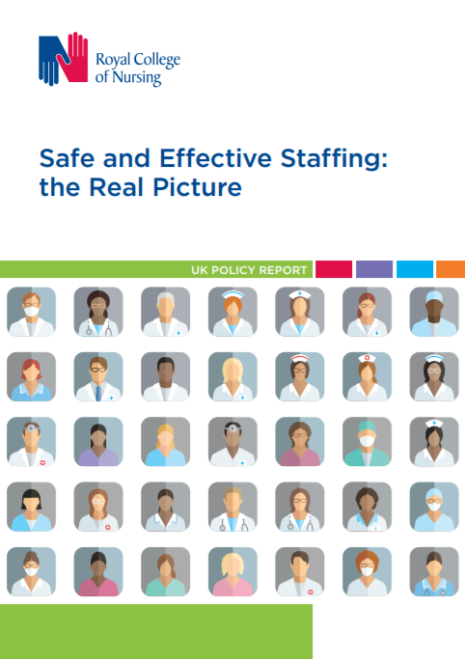
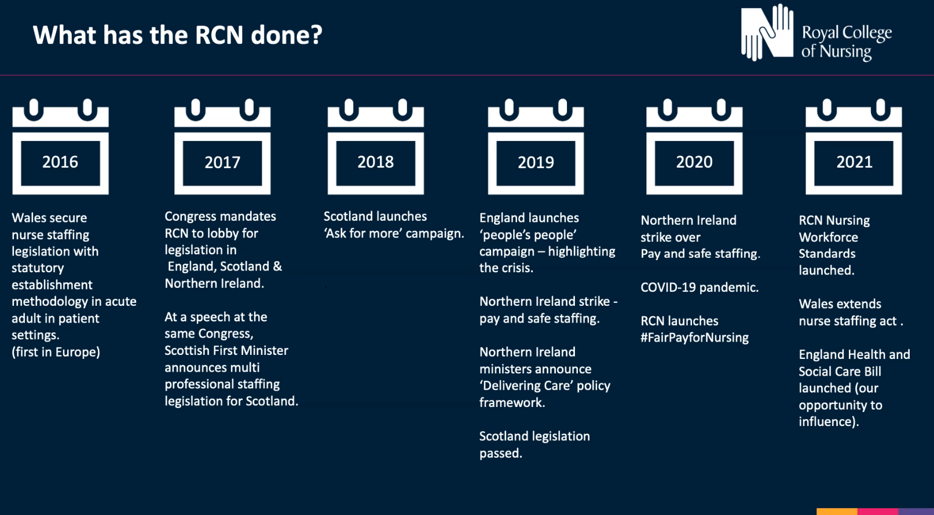

Notes:
This slide provides a timeline to the UK staffing for safe and effective care campaign to date.
Publications:
SSEC: The real picture: https://www.rcn.org.uk/professional-development/publications/pub-006195
published May 2017
SSEC: against the odds: https://www.rcn.org.uk/professional-development/publications/pub-006415
A summary of a member survey
Sept 2017
SSEC in the UK: https://www.rcn.org.uk/professional-development/publications/staffing-for-safe-and-effective-care-pub-008067
January 2020

Slide 4
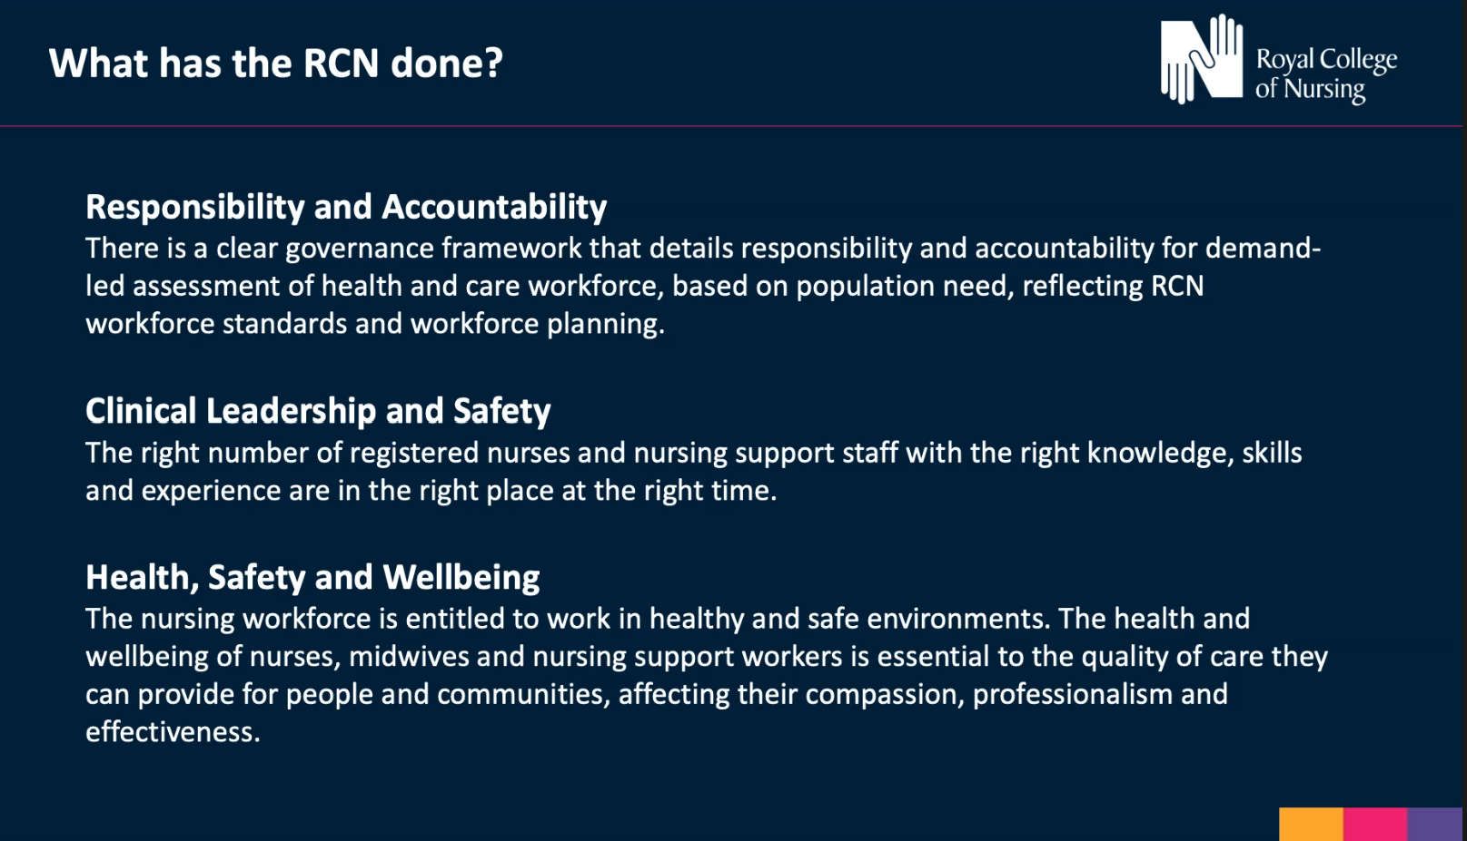
Notes:
We have developed a set of key principles

Slide 5



Nursing Workforce Standards
Chair of the RCN's Professional Nursing Committee, Rachel Hollis, introduces the College's first national standards for delivery of safe and effective care.
Watch the video
Notes:
The video is also available on the webpage: http://www.rcn.org.uk/nursingworkforcestandards

Slide 6


About the Standards
The Standards set out the position of the Royal College of Nursing based on evidence and professional expert consensus. They are important for our work as both a professional body and as the largest trade union for nurses.
The standards apply across all areas of nursing and all health and care sectors across the United Kingdom.
The Standards are designed to support a safe and effective nursing workforce alongside each nation’s legislation.
The 14 Standards are grouped into 3 key themes:
  Responsibility and Accountability – 4 standards
  Clinical Leadership and Safety - 6 standards
  Health, Safety and Wellbeing - 4 standards
Notes:
Introduction to the nursing workforce standards.

Slide 7
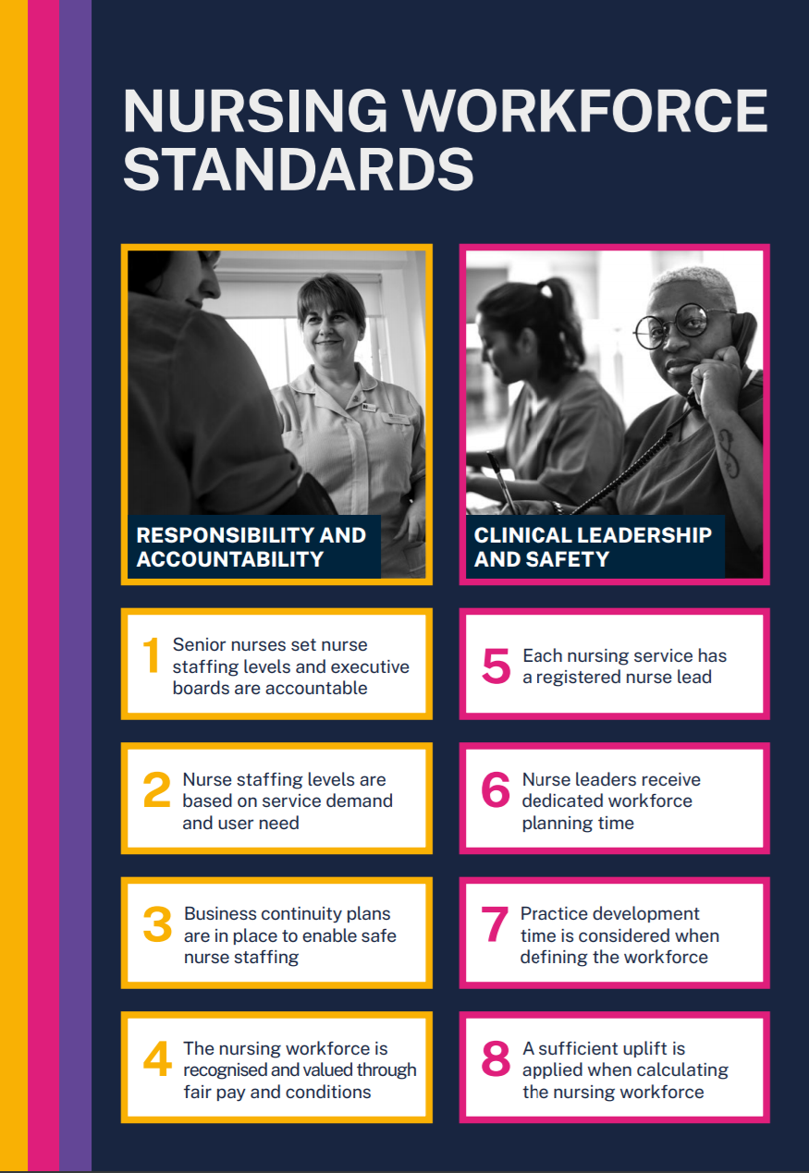

Notes:
This provides a good high level summary of the 14 standards.
It is a pdf poster that is available using the URL or website: www.rcn.org.uk/professional-development/publications/rcn-workforce-standards-uk-pub-009681
Each of the standards has detail in the narrative that is very powerful and influential, each section has a letter to facilitate easy reference e.g. 1a,b,c
Depending on length of presentation time you can work through the 14 high level standards.

Slide 8

Find out more about the RCN's Nursing Workforce Standards

Slide 9

Responsibility and accountability

Slide 10

Clinical leadership & safety

Slide 11

Health, safety and wellbeing

Slide 12
Importance of nurse leadership
Standard
5
Standard
6
Examples
Each nursing service has a registered nurse lead
Nurse leaders receive dedicated workforce planning time
5a - Each team & service (e.g. Ward/ Community team/ Nursing Home) should have a registered nurse lead.
5b –If it is a wider MDT team and not managed by a RN then there must be a clear line to nursing leadership.
6a – Should be 100% supervisory (i.e. not planned to be in the numbers) – if not needs to be a documented exception and reported to board.
6b – list of what this resource and time is for.
6c – Role within leadership team needs to be included in job descriptions.
Notes:
This is a an example of the detail in the standards.
6b – b) Resources and time are required for:
leading and management of the team
improving and monitoring the quality of care experienced by people who use a service
workforce planning, monitoring and associated activity
budget management
clinical audit and regulatory audit
initiating quality improvement programmes
research
clinical supervision and staff development
monitoring health and safety data for adverse incidents involving staff and people who use services.

Slide 13

Stanrds
Nursing Workforce Standards
Legislation
Escalation guidance
Pay
Staffing for Safe and Effective Care
Notes:
The standards are part of a wider work as part of the RCN Staffing for safe and effective care campaign:
Escalation guidance was published in November 2020 and will be discussed later in presentation.
The standards webpages link to each country legislation & where there is none e.g. England we are lobbying for this.
Pay campaign

Slide 14
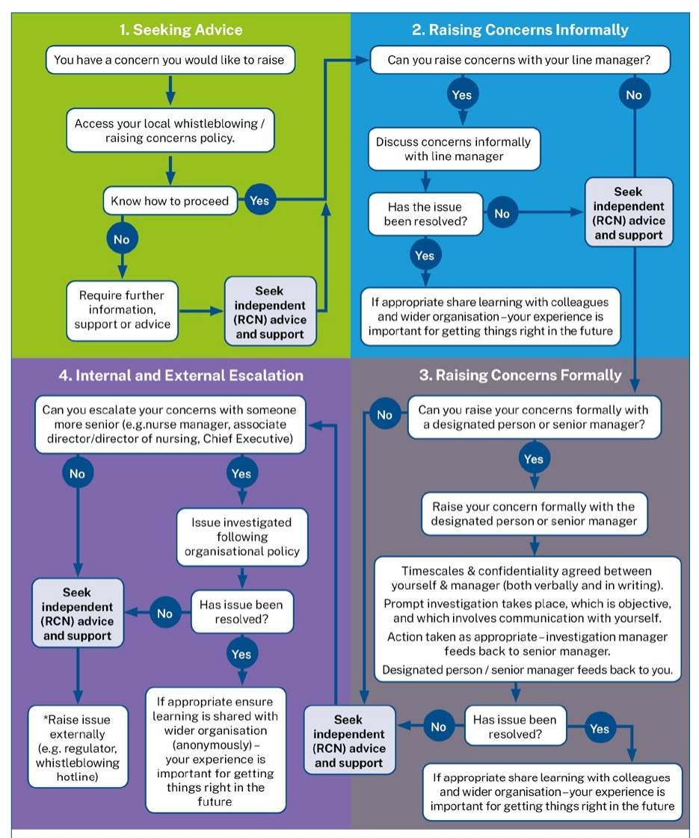
They are part of a suite of resources to drive standards towards ‘staffing for safe and effective care’.
Where the Standards are not met, action can be taken in line with RCN guidance on 'Raising and Escalating Concerns’ (June 2023)
View the publication
Notes:
Raising and Escalating | Publications | Royal College of Nursing (rcn.org.uk)
On the standards webpage there are also links to:
Raising concerns letter re staffing for nurses
Raising concerns letter for nursing support workers
https://www.rcn.org.uk/covid-19/covid-19-raising-concerns-letter
https://www.rcn.org.uk/covid-19/covid-19-raising-concerns-letter-for-nursing-support-workers

Slide 15
Country specific slides
This section is currently in development and will be uploaded soon

Slide 16
Setting specific slides

Slide 17
Nursing within a specialism
Clinical
Leadership
Education & research
Standard 2: Establishments meet demand, are reviewed and reported to board who are accountable
Standard 2b: Workforce data review at least monthly
Standard 2f: Double counting, for example, if on a multi-professional rota should not also be counted in nursing numbers for that clinical area
Standard 2h: Students are supernumerary.
Standard 9: Substantive 80%+
Standard 5a: Registered nurse lead for nursing teams
Standard 5b: Link to nursing leadership is essential (e.g. if part of wider MDT/rota)
Standard 6: Time to lead.
Admin support
Standards 6a&b: Leadership parts of job plan should be supervisory and not included in the numbers
Standard 6c: Role within leadership team needs to be included in job descriptions
Standard 7 : Practice development including CPD and clinical supervision
Standard 8: Uplift
Standard 8b: Sets out what must be considered
Standard 8c: Professional judgement considerations
Standard 10: CPD – appropriately prepared and work within scope of practice

Slide 18
Executive Level Nurses
Standard
1
Examples
Senior nurses set nurse staffing levels and executive boards are accountable
1a – There should be an executive level nurse.
1b – If not (e.g. small organisation/ company) this should be a documented exception that is documented, reported and reviewed. This can then be supported or challenged by commissioners and regulators.
1c – Whole board are accountable.
1d - The nursing workforce establishment should be determined by the demand for services and the
need to provide safe and effective care.
1e. Setting the nursing workforce establishment should explicitly inform the organisation’s financial planning and be funded by revenue allocation rather than fitting a prescribed financial envelope.
1f - In setting the nursing establishment workforce planning and decision making should be underpinned by professional nursing knowledge and experience. The responsibility for setting nursing establishments remains with the executive nurse.
1g - Nurse leaders are integral to contracting and commissioning care in order to distinguish between nursing specific workload and that of the wider multi-professional workforce.
1h - Decisions on nurse staffing must be recorded. Discussions must detail the workforce requirements of the organisation/service in order to provide staffing for safe and effective care.
1i -Each organisation should have a board-approved risk management and escalation process in place to enable real-time nurse staffing risk escalation and mitigation with clear and transparent procedure to address severe and recurrent risks.
Notes:
Summary of standard 1

Slide 19
Executive Level Nurses
Standard
2
Examples
Nurse staffing levels are based on service demand and user need
2a – The nursing workforce will be a standing item for discussion at the board or accountable body for decision making in any organisation providing nursing services.
2b – Workforce data should be reviewed at least monthly and ‘red flags’ such as high rates of sickness or turnover investigated with transparency.
2c – A framework should be in place that enables regular review and decisions about service provision and workforce resourcing.
2d - A continuous quality improvement approach to staffing should be taken. A triangulated approach is required and will include:
professional judgement
patient-dependency/acuity
workload tools
clinical quality indicators
nationally agreed standards
peer reviewed published evidence
benchmark data from matched comparators who can evidence the delivery of high-quality person centred services and/or data linkage to care quality indicators.
2e - Once any review is completed, an action plan should be created to address any issues identified.
2f - Where there are nurses rostered within a multi-professional workforce rota, they cannot be counted twice.
2g. Staff who support the workforce,
such as clerical, housekeeping
and catering staff, should not be
considered within nursing workforce
numbers when determining the
nursing establishment to meet clinical
need.
2h. All nursing students must be
supernumerary when in training.
Notes:
A summary of standard 2

Slide 20
Executive Level Nurse examples
A Director of Nursing presents the standards to the executive board particularly highlighting Standard 1c-i & 2a. With the nursing workforce now a standing item this is then used to work through the various standards highlighting where compliance exists and how to make step changes towards achieving this where there are gaps.
Examples:
Standard 6 set’s out the supervisory role of ward/team leaders, the DoN has worked with the nursing leadership team and determined currently this occurs on average 33% of the time. The amount of additional wte band 5/6 is calculated to initially get this to 50% within 1 year, 75% by year 2 and 100% by year 3. A business case can then be developed.
Standard 8 sets out what should be included to calculate uplift. 8a,b and c are used to evidence base a review and proposed new uplift % for the trust.
Standard 9 is used to instigate reporting every time substantive nursing workforce falls below 80%. The DoN can use the regular board agenda item to raise this which is a regular occurrence as agency/ bank use often above 20%. This is used to prompt a discussion regarding what can be done to both elevate and mitigate the problem as well as ensure risk recognised and recorded.
The internal quality assurance framework can also be reviewed and adjusted to incorporate the standards as part of the assessment process and to evidence base change. This is useful to prepare for regulator visits ect.
Notes:
An example of how the standards can be used by an executive level nurse to influence change.

Slide 21
Independent sector example
An Independent sector Chief Nurse is not currently executive level and reports to the Medical Director. Whilst on the senior management team they do not have a seat on the board.
The standards are used to highlight the need to an executive level nurse and if not 1b states that this should be a documented exception. This is used to start the conversation, challenge the corporate board and also 1c sets out that the whole board is accountable for nursing workforce.
Standard 2a also states that nursing establishment should be a standing item on each board meeting. All of these factors together make a strong case for the Chief Nurse to become an executive level post.
Notes:
Example of using the standards to influence change in an independent sector setting and also for nurse leaders who are not executive level.

Slide 22
Care Home examples
A care home with nursing is looking to recruit a registered manager that is not a registrant. Standard 5a can be used to argue against this as ‘each clinical team or service that provides nursing care will have a registered nurse lead’.
There is a high reliance on agency and temporary staff particularly on night shifts. Standard 9, states that when the substantive staff ratio falls below 80% this should be reported (to the corporate board, likely management board in smaller homes). 9a includes ensuring continuity of care.
One organisation suggested that they stopped having an RN overnight and substituted with a NSW and an on-call RN available by phone. There are lots of reasons why this could be challenged, and the standards add to this: Standard 1 (accountability: board level, in this setting likely to include owners in smaller establishments) 1a – includes responsibility to those who contract or commission services. Standards 2 – all and b,c very useful here.
Insufficient time for CPD, struggle to ensure statutory & mandatory training. Standard 10 sets out what is required and Standard 8 covers ensuring uplift in establishments is sufficient.
Notes:
Examples of how the standards can be interpreted within the care home (with nursing) setting.
Narrative followed by two slides with the related standards summarised.

Slide 23
Care Home setting
The Nursing Workforce Standards are applicable to this setting and will be a very useful tool to drive change.
There are 14 standards and all have descriptors e.g. 1a,b,c
Standard
1
Standard
5
Examples
Senior nurses set nurse staffing
levels and executive boards are accountable
Each nursing service has a registered nurse lead
1a – There should be an executive level nurse.
1b – If not (e.g. small organisation/ company) this should be a documented exception that is documented, reported and reviewed. This can then be supported or challenged by commissioners and regulators.
1c – Whole board are accountable.
5a - Each team & service (e.g. Nursing Home/ Care Home with nursing) should have a registered nurse lead (standard 6 sets out dedicated time & resources for this).
5b –If it is a wider MDT team and not managed by a RN then there must be a clear line to nursing leadership.

Slide 24
Care Home setting
Standard
10
Examples
Nursing staff are prepared and work within their scope of practice
10a - This includes access to CPD, education, support and development to ensure the nursing workforce has the knowledge, skills and competencies required to deliver evidence based, safe, person-centred care that is of high-quality.
As a minimum this needs to include:
safeguarding
mental capacity
consent record keeping
basic life support
competency frameworks specific to the area of specialty the principles of accountability and delegation
raising concerns
health and safety related training including moving and handling, infection prevention and control and fire training.
10b - The registered nurse lead will
ensure that:
individuals appointed to the nursing workforce, including those in management roles, are allocated a period of supernumerary induction / preceptorship
individuals with no previous experience should have a preceptorship period which includes structured induction and close supervision until specialty competence and confidence are achieved
for more senior/experienced staff taking on additional or different roles, a preceptorship period is still needed until competence and confidence are achieved.
10c - For staff who are lone workers, there must be clear access to advice, supervision and support at all times as well as compliance with necessary health and safety requirements.
10d - Fostering leadership capability is integral to all members of the nursing workforce throughout their career to embed a psychologically safe culture and strengthen the nursing voice.

Slide 25
Advanced Nursing Practice example
An advanced clinical practitioner (nurse) is working on a multi-professional rota on the medical take, based mainly on the Acute Medical Unit. There are nursing staffing issues on AMU today due to sickness and vacancies and the Matron said in passing that they will need to also count you in the numbers today on AMU because if not the dashboard will be red.
Standard 2f states that this shouldn’t happen and that a nurse can’t be counted twice. This includes those that are rostered on any multi-professional rota.
Notes:
Case example: using the standards to influence change in advanced practice.
The standards can also work along side the RCN Advanced Practice Standards - https://www.rcn.org.uk/professional-development/advanced-practice-standards

Slide 26
Advanced Nursing Practice
Clinical pillars
Leadership pillars
Education & research pillars
Standards 2 – Establishments meet demand, are reviewed & reported to board who are accountable
2b – workforce data review, at least monthly
2f – Double counting: for example if on a multi-prof rota shouldn’t also be counted in nursing numbers for that clinical area.
2h – Students are supernumerary
Standard 9 - Substantive 80%+
Standard 5a – Registered Nurse Lead for nursing teams.
b - link to nursing leadership essential e.g. if part of wider MDT team/ rota.
Standard 6 – Time to lead
6a,b Leadership parts of job plan should be supervisory & not in the numbers.
6c – Role within leadership team needs to be included in job descriptions.
Standard 7 – Practice development including CPD and Clinical Supervision
Standard 8 – Uplift
8b set’s out what must be considered
8c professional judgement
Standard 10 – CPD – appropriately prepared and work within scope of practice
Notes:
Interpretation of the standards for advanced nursing practice, mapped to the four pillars of advance practice

Slide 27
Justice and Forensic Settings
Police custody
Prison
Court
Sexual Assault Referral Centres
Substance use services
Low, medium and high secure forensic mental health services
Community forensic mental health care

Slide 28
Justice and Forensic Settings
Standards
1 - 4
Examples
Responsibility and Accountability
Often independent providers in situ, sometimes without strong, audible nurse leadership, which impacts on the way in which the nursing voice is heard
In many areas, the medical model prevails which can impact on nursing support and development (e.g. clinical supervision)
Recruitment is a significant issue with poor understanding of the area by the wider nursing community, delays in security clearances and the provision of safe, effective workplaces for staff (e.g. converted cells as clinic rooms)
Business continuity plans need to take account of things not normally associated with healthcare including riots, civil unrest, security lockdowns and high levels of aggression
Some independent providers do not have equitable NHS T&C and there are sometimes no recognised relationships with trade unions
Notes:
Summary of standard 1

Slide 29
Justice and Forensic Settings
Standards
5 - 10
Examples
Clinical Leadership and Safety
Not always a registered nurse leader in justice settings
The nursing voice competes with the medical and security discourses. Strong nursing leadership is crucial
Chronic staff shortages lead to less time for senior nurses to focus on leading and managing the team
Models of service provision do not hold practice development in high esteem – focus on meeting immediate clinical need
Workforce planning does not take account of the physical environment – long distances across prisons and patients in small, confined spaces (cells)
Reliance on temporary staff, who become permanently temporary given constraints of access (security clearance)
Needs to be recognition that the preparation for the nursing role in these settings includes areas not traditionally related to healthcare (security, ‘jailcraft’, conditioning etc)
Notes:
Summary of standard 1

Slide 30
Justice and Forensic Settings
Standards
11 - 14
Examples
Health, Safety and Wellbeing
Rostering patterns can be entrenched in custom and practice, particularly with regards to long days and nights
Secure healthcare settings can be ‘hidden from view’ and staff can feel invisible from the nursing community. Can feel professionally unsupported when raising concerns. Particularly difficult when caring for mariginalised population about whom the public can be very negative
Physical working environment can be challenging – old buildings, small spaces, poor facilities for staff
Patient care and staff care are sometimes competing priorities. Self care needs to be role modelled by leaders
Notes:
Summary of standard 1

Slide 31
Feedback & links and closing slide

Slide 32
Support for the Standards
Andrea Sutcliffe, Chief Executive and Registrar of the NMC: ‘’This is useful guidance from the RCN that nurses and their employers can use to assist them navigate the operational challenges they face to deliver the safe, kind and effective care our communities need.”
Saffron Cordery, Deputy chief executive of NHS Providers: “We agree with the RCN that enough staff need to be recruited and retained not only to address existing workforce gaps, but to help build vital flexibility into the system to protect staff wellbeing and development. NHS bodies must recognise the specific workforce needs that have emerged or been reemphasised this past year, to ensure that the correct lessons are learnt.’’
Rebecca Smith, Managing Director of NHS Employers: “Employers will welcome these workforce standards for nursing. Nurses are at the heart of our NHS teams, and these standards will help to ensure that is recognised, so that nursing staff can continue to provide safe and effective care to patients and communities, while also ensuring they are properly cared for and supported themselves.”
Notes:
These are some supportive comments from stakeholders regarding the standards. We have also received positive feedback from regulators such as the CQC.

Slide 33
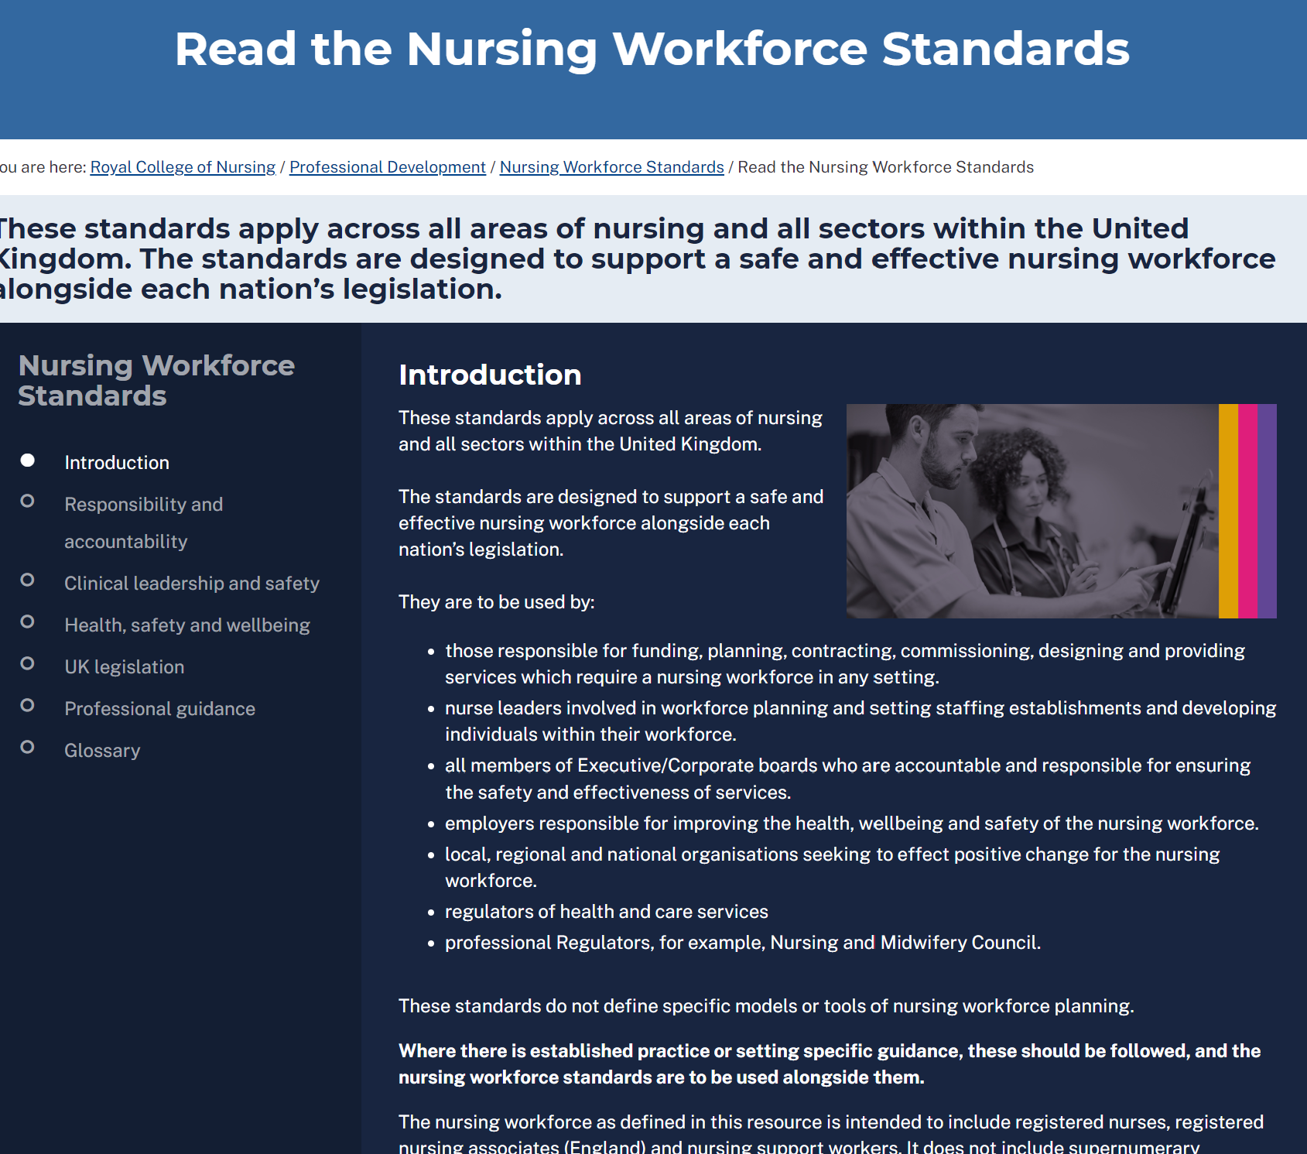
How are the Standards presented?
Online resource : www.rcn.org.uk/nursingworkforcestandards
FAQs
Additional resources to support the standards
Links to psychological escalation guidance
Links to legislation and professional guidance where it exists.
The RCN vision
Every member of the nursing workforce uses the Standards in part or in whole to support
them as an individual or on behalf of a nursing workforce.
The Standards will become as well known as the NMC Code.
The Standards are used to uphold safe and effective staffing for the nursing workforce UK-wide.
Notes:
Nursing Workforce Standards | Professional Development | Royal College of Nursing (rcn.org.uk)
FAQs Nursing Workforce Standards FAQs | Professional Development | Royal College of Nursing (rcn.org.uk)

Slide 34


Any questions?

